Slide 1

GDTE
THE FOURTH GLOBAL DIGITAL TRADE EXPO
Exhibitor Registration Instructions
中国·杭州 Hangzhou , China

Slide 2
Contents
Exhibitor Registration
Exhibitor Badge Application
Complete Company Information
Personal Information Settings

Slide 3

Exhibitor Registration

Slide 4



Official Website
​​Visit the official conference website​​:
https://www.gdte.org.cn → Click ​​"Digital Trade Online"​​ in the navigation bar.
​​Directly access the Digital Trade Online platform​​:
https://www.gdteonline.com
PC/H5
WeChat Mini Program
Alipay Mini Program

Slide 5
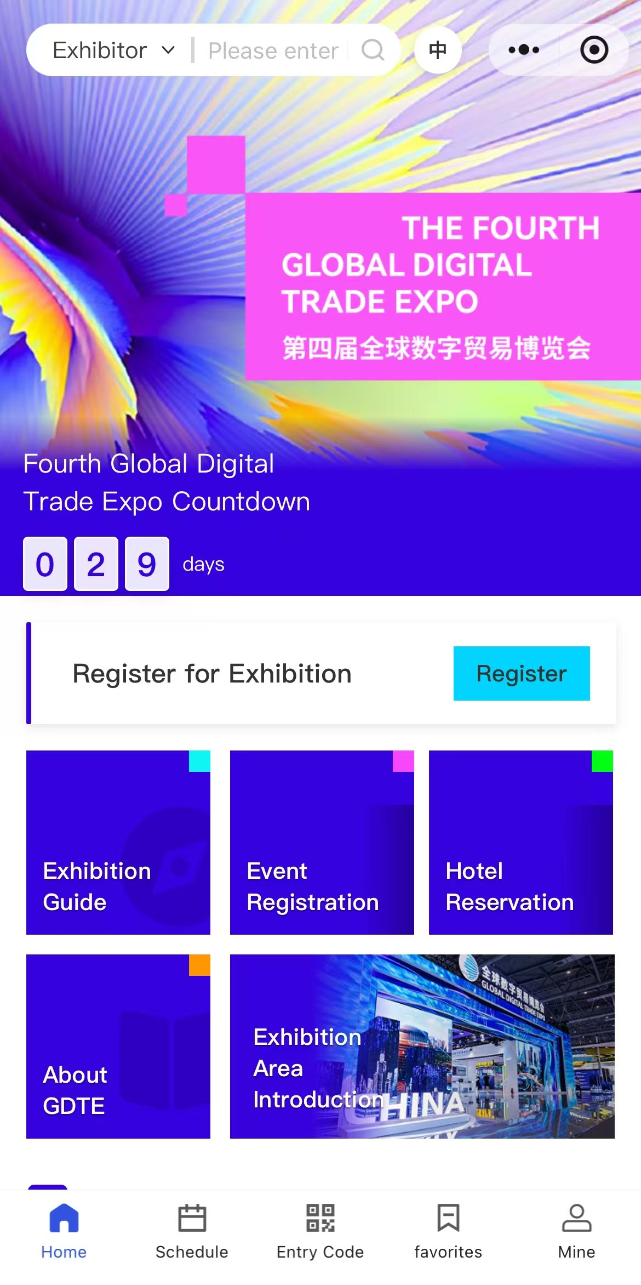
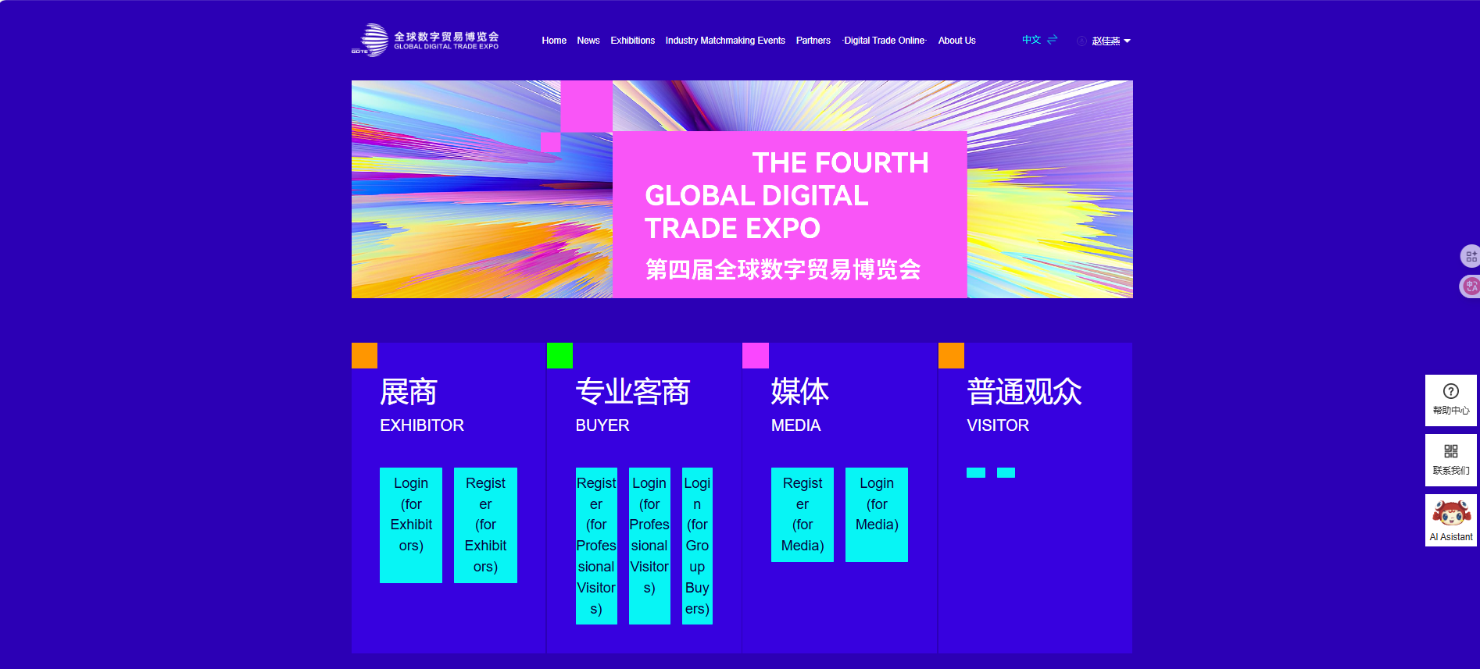
Exhibitor Registration
Click [Exhibitor Registration] on the website, or tap [Exhibit Application] in the mini-program to complete your registration.
PC/H5
Mini Program/H5

Slide 6

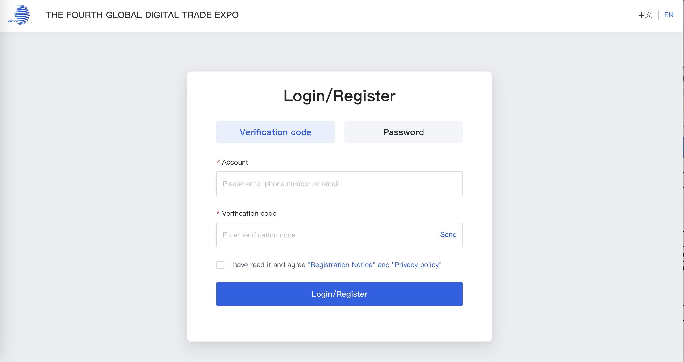
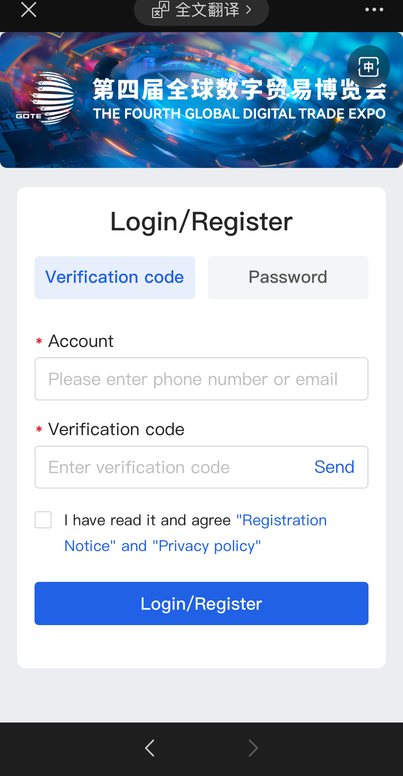
Exhibitor Registration
Access the exhibitor login/registration page,Enter your email address, then obtain the verification code to register/log in to your account.
Note: Exhibitors do not need to use password login during the registration/login stage.
Exhibitors must use email address (not phone number) for registration and login.
PC/H5
Mini Program/H5

Slide 7
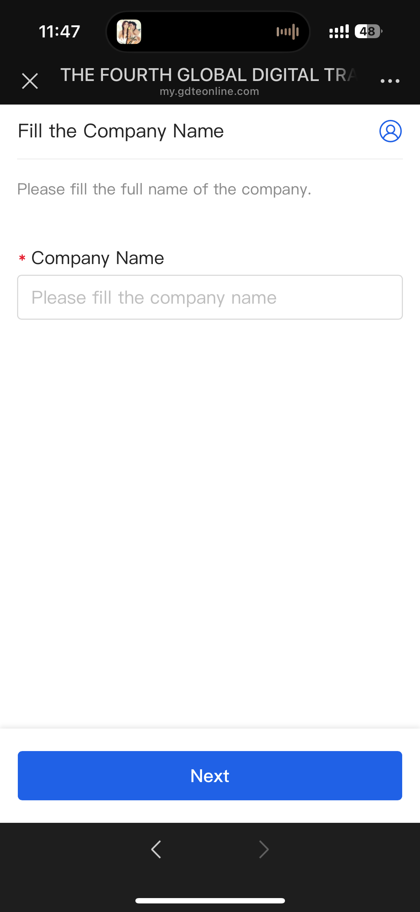
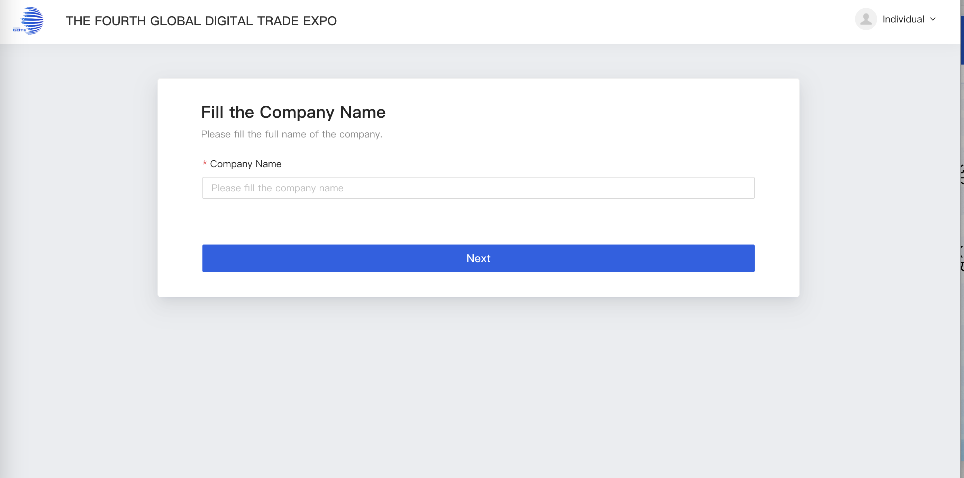
Exhibitor Registration
Please enter your company name and click [Next].
*The [Company Name] field is your publicly displayed name. Please enter it carefully, as this field is unique—once a company name has been registered, it cannot be used again by another account.
PC/H5
Mini Program/H5

Slide 8
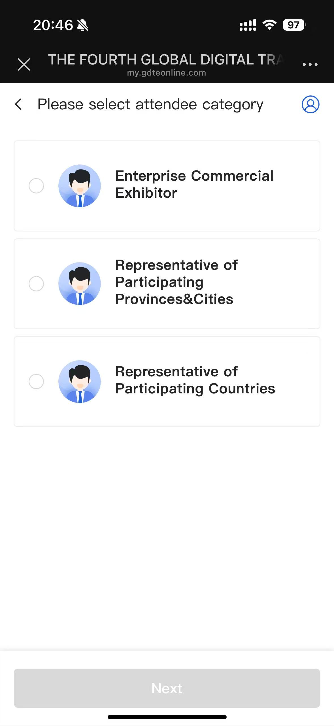
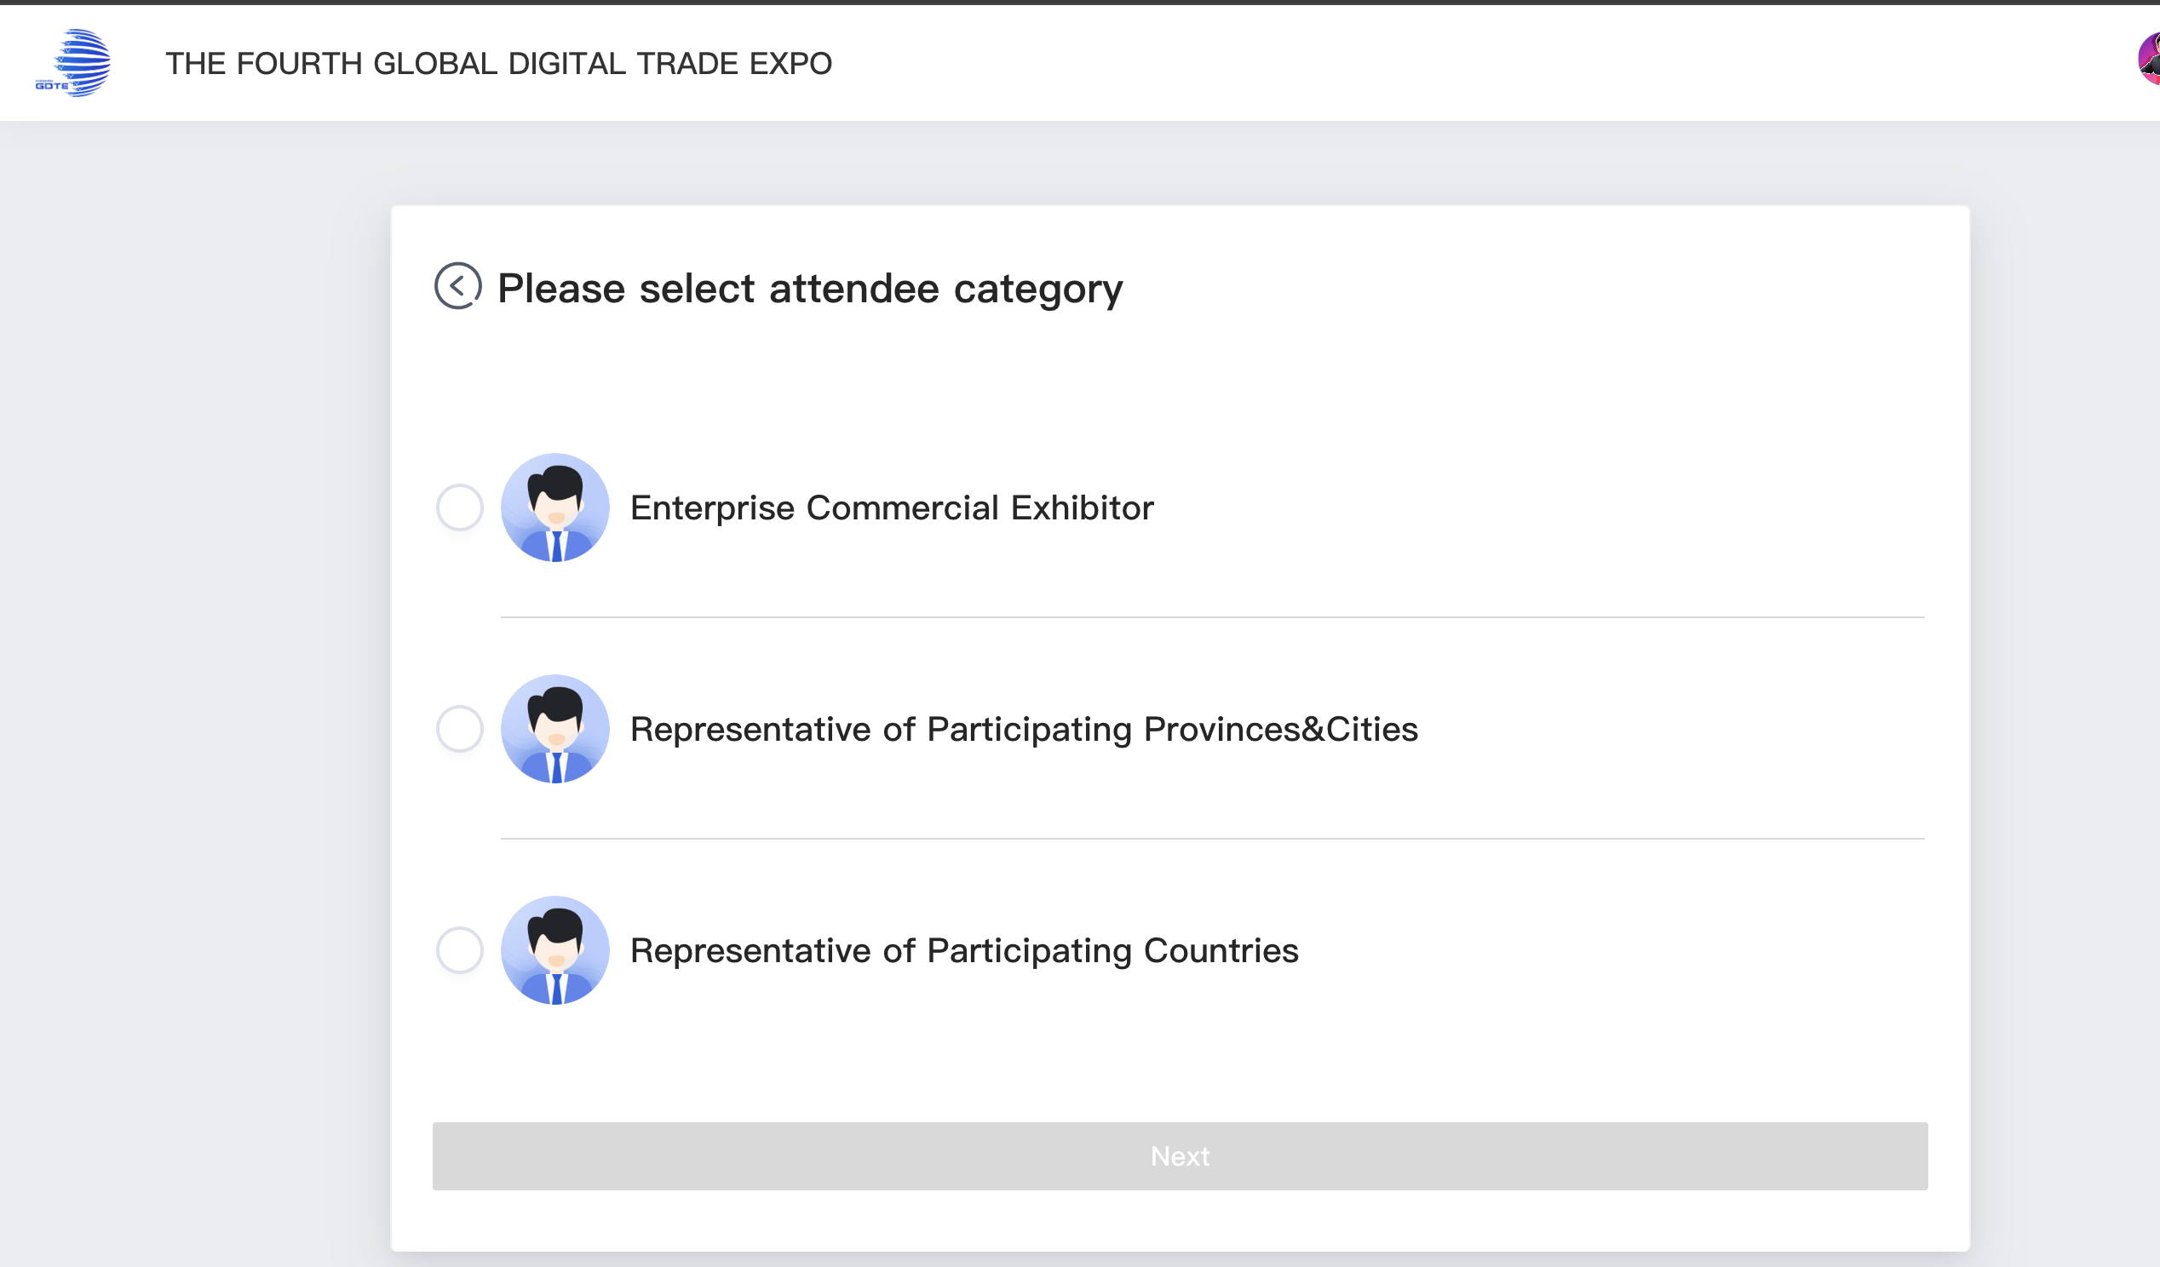
Exhibitor Registration
Please select attendee category and click [Next].
PC/H5
Mini Program/H5

Slide 9
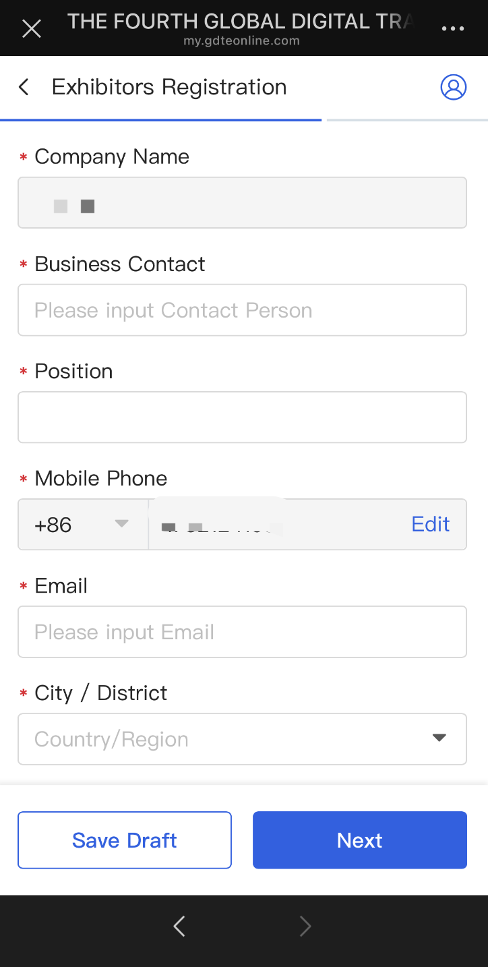
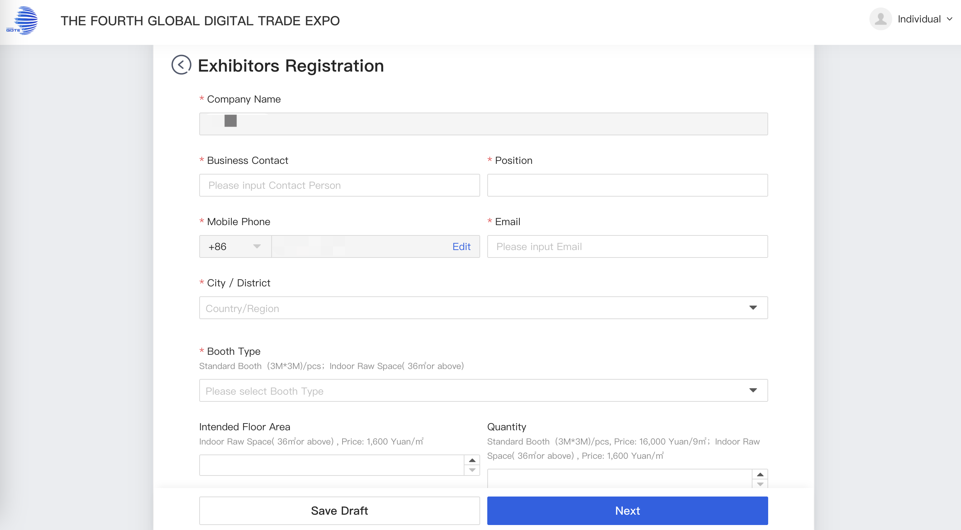
Exhibitor Registration
Please complete the exhibitor's company registration information and click [Next].
【Mobile Phone】When registering with your email, the phone number entered will only function as a contact method and cannot be used to log in.
【City/District】 Please specify the city of your company's headquarters.
【Booth Type】Standard Booth → Number of booths;Special Booth → Area (㎡)*
PC/H5
Mini Program/H5

Slide 10
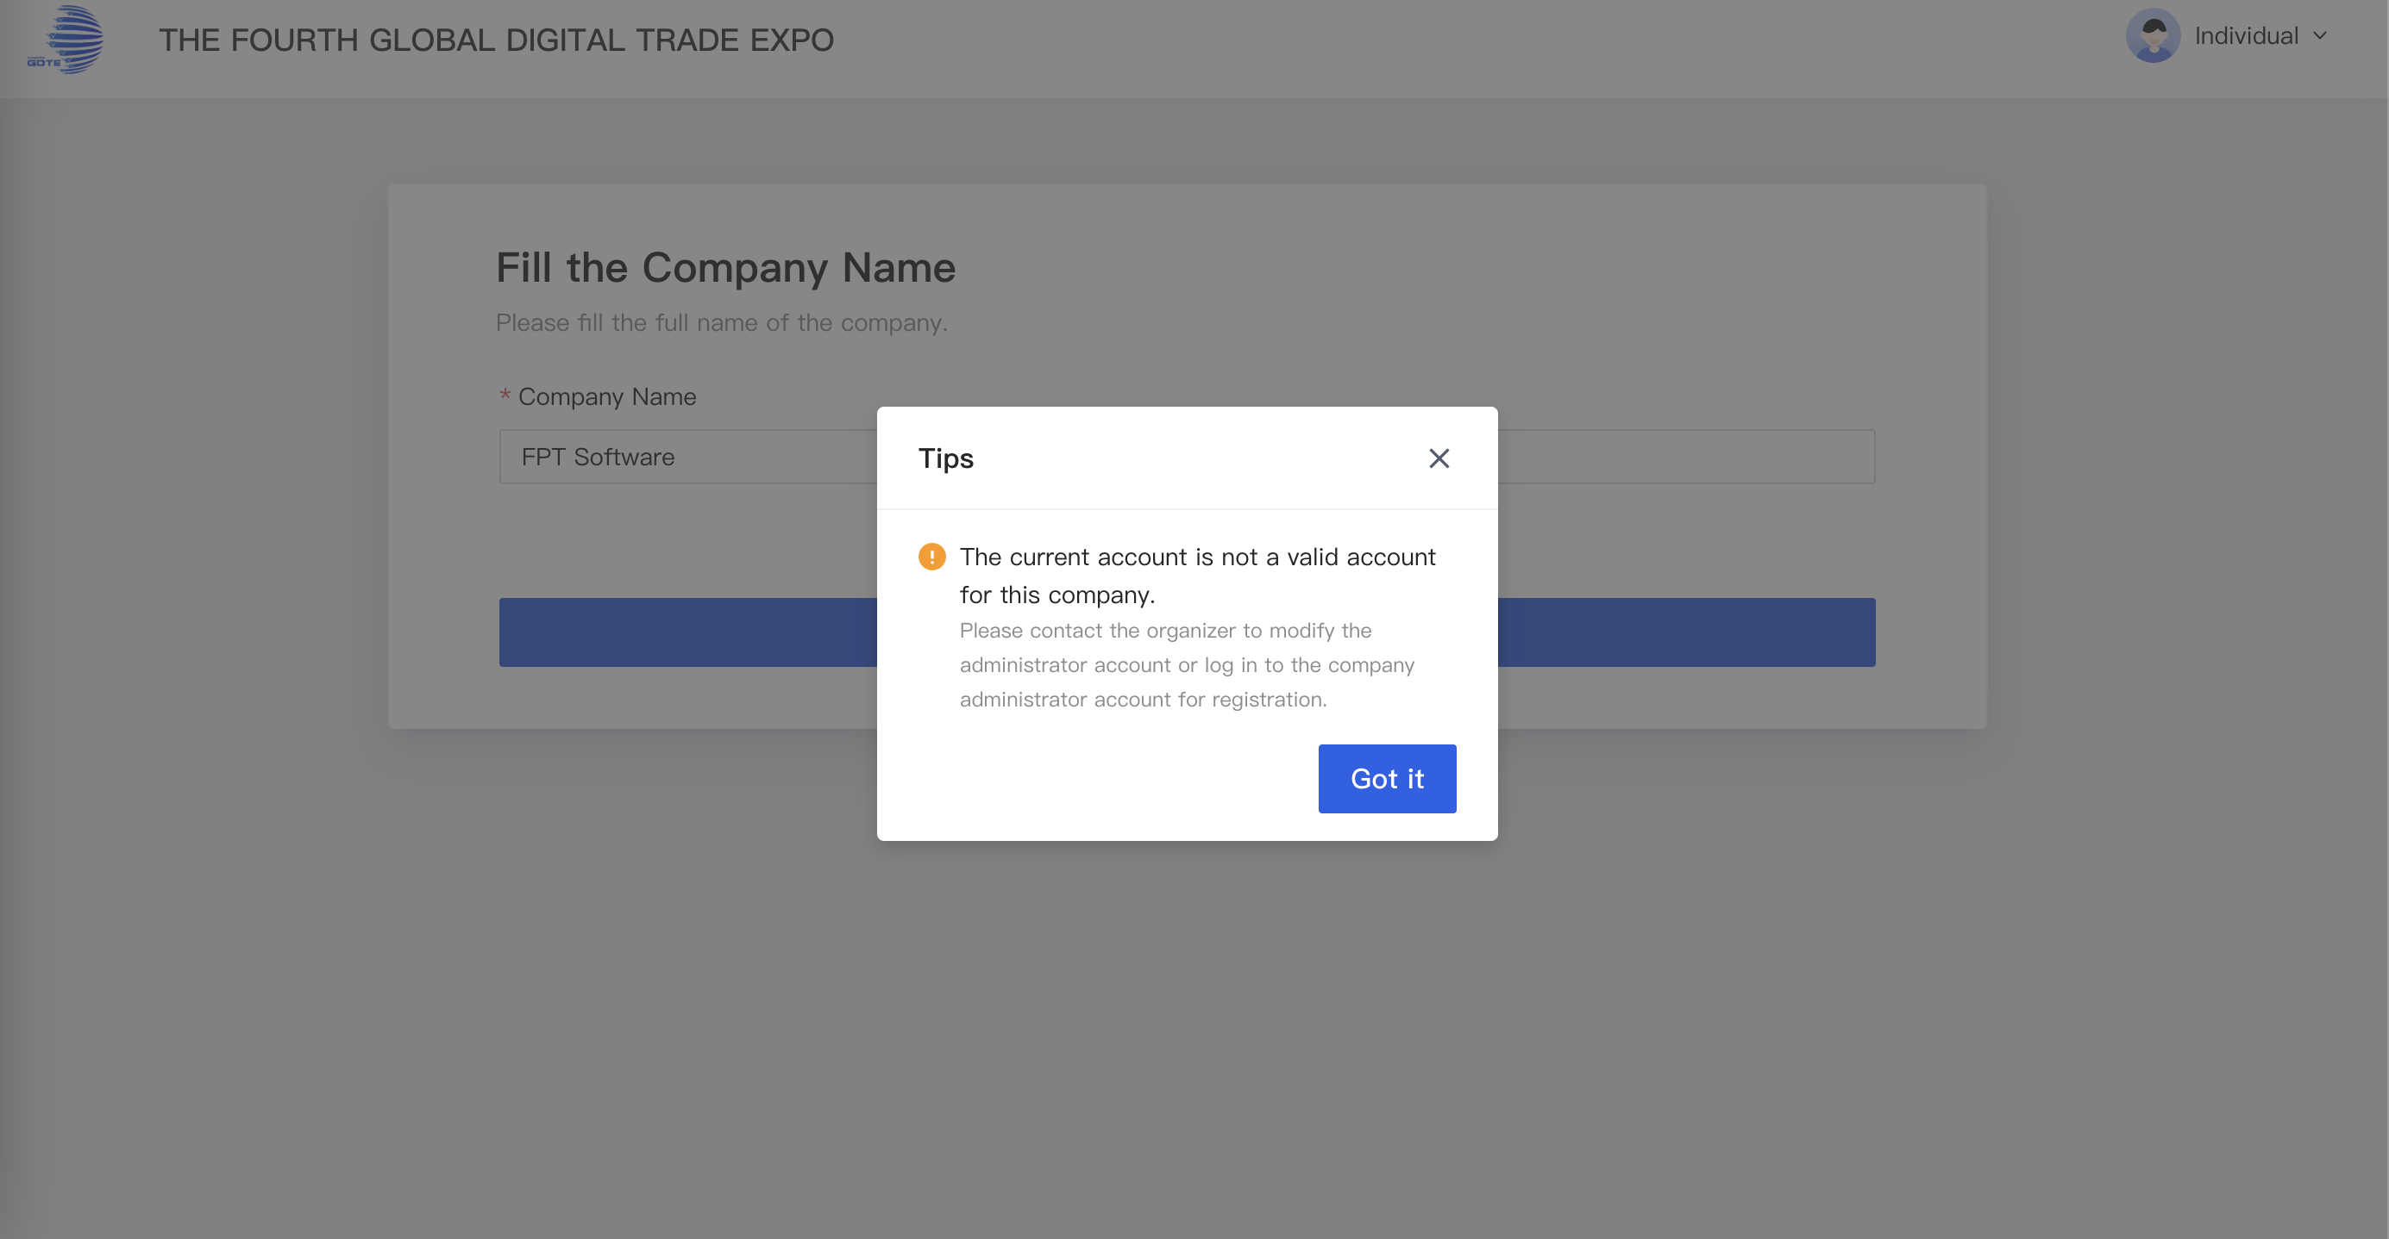
Exhibitor Registration
If during the registration process you encounter the situation shown below, it indicates this exhibitor name is already registered. You must contact your pavilion manager, who will assist in updating the email address linked to the previous exhibitor account through the following methods.
PC

Slide 11
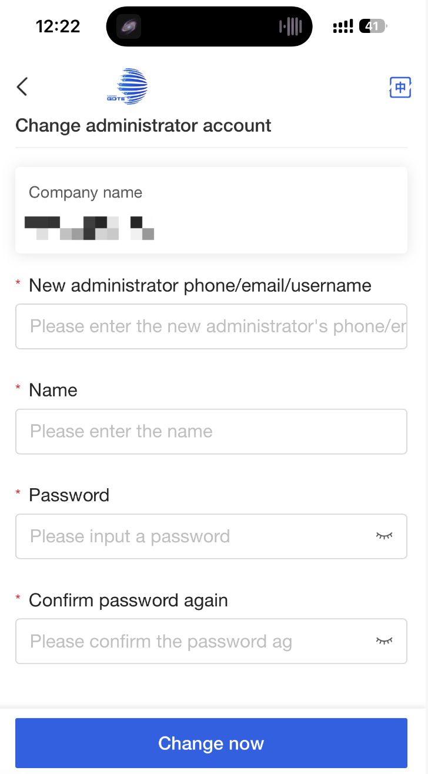
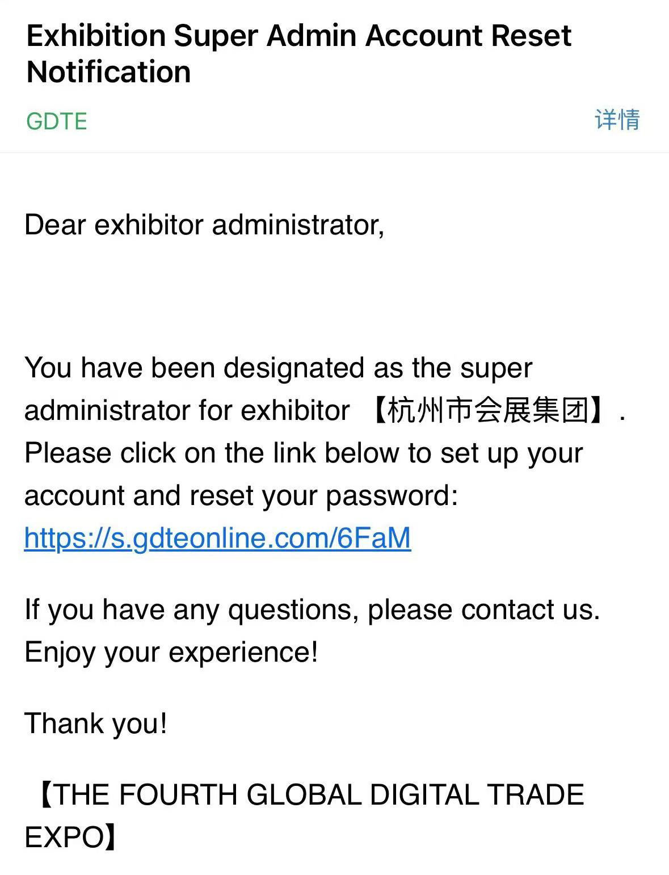
Exhibitor Registration
Change Company Super Administrator
After the pavilion manager processes the request, you will receive an SMS link as shown.
Click the link to access the update page, where you may enter the new email address
to complete binding with your company name.
Message/Email
Mini Program/H5

Slide 12
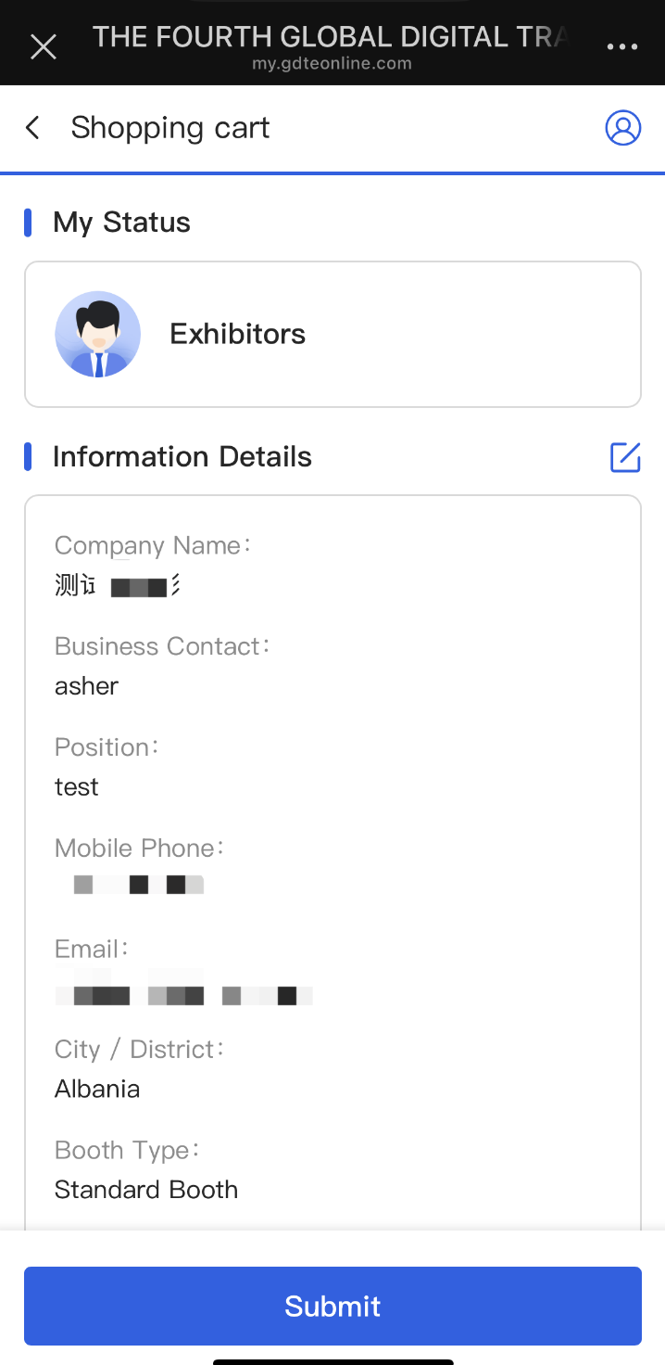
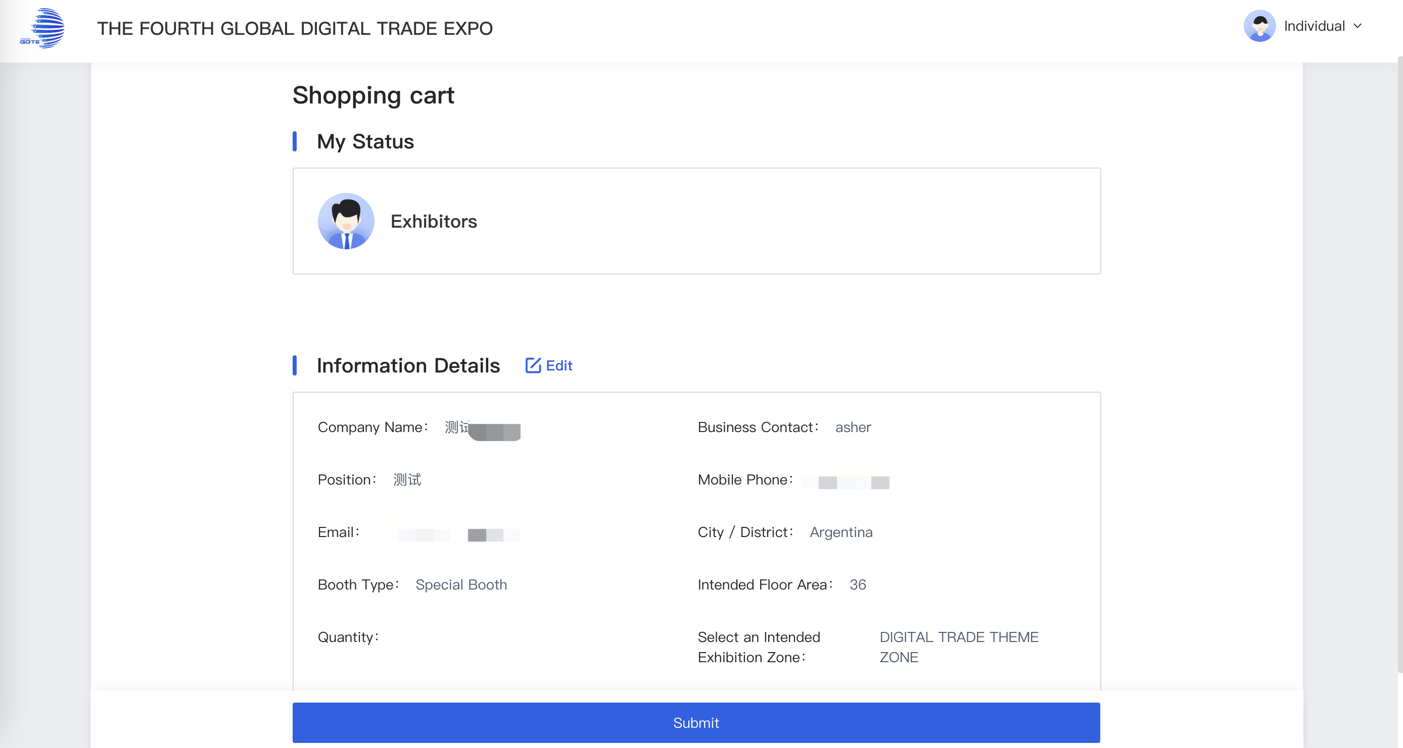
Exhibitor Registration
Before proceeding, please:
Thoroughly review all entered information
Click [Edit] to correct any inaccuracies
Click [Confirm Submission] to finalize and send for review
PC
Mini Program/H5

Slide 13
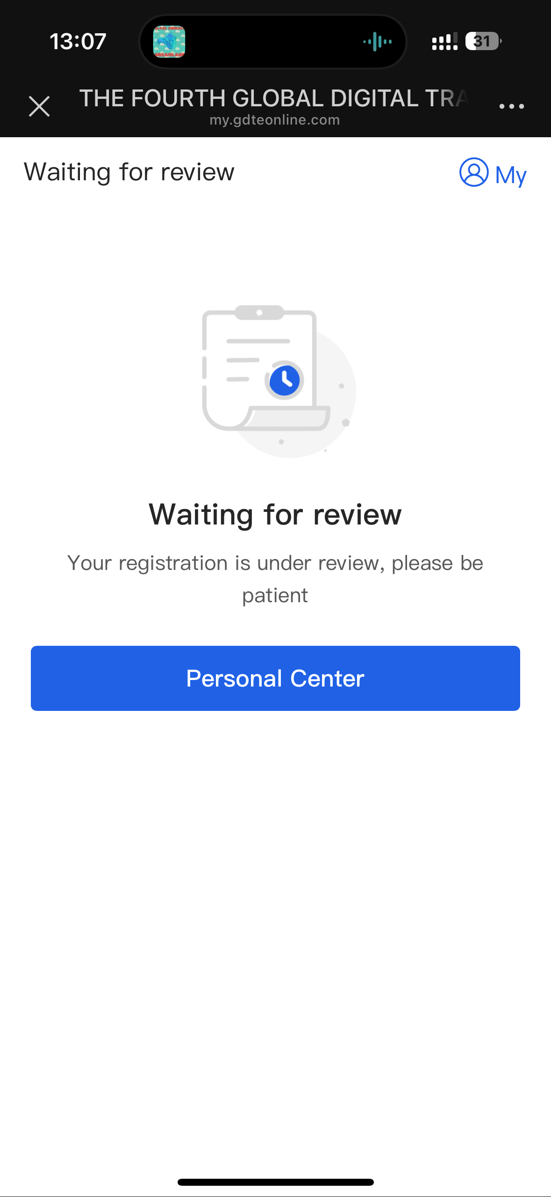
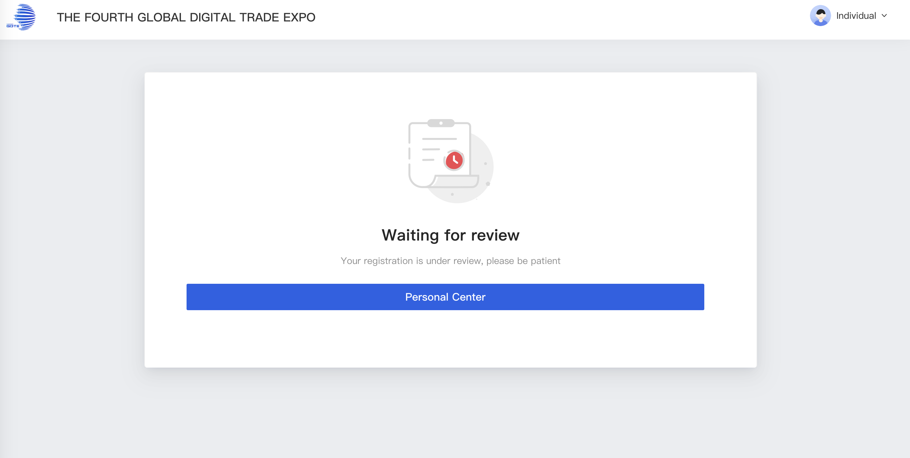
Exhibitor Registration
Next Steps After Submission:
1.Access your submission status anytime through:
2. [Personal Center] in the app.
3. Exhibitor Login portal (Email verification code or password required) on our (GLOBAL DIGITAL TRADE EXPO)website.
PC
Mini Program/H5

Slide 14
Exhibitor Badge Application

Slide 15
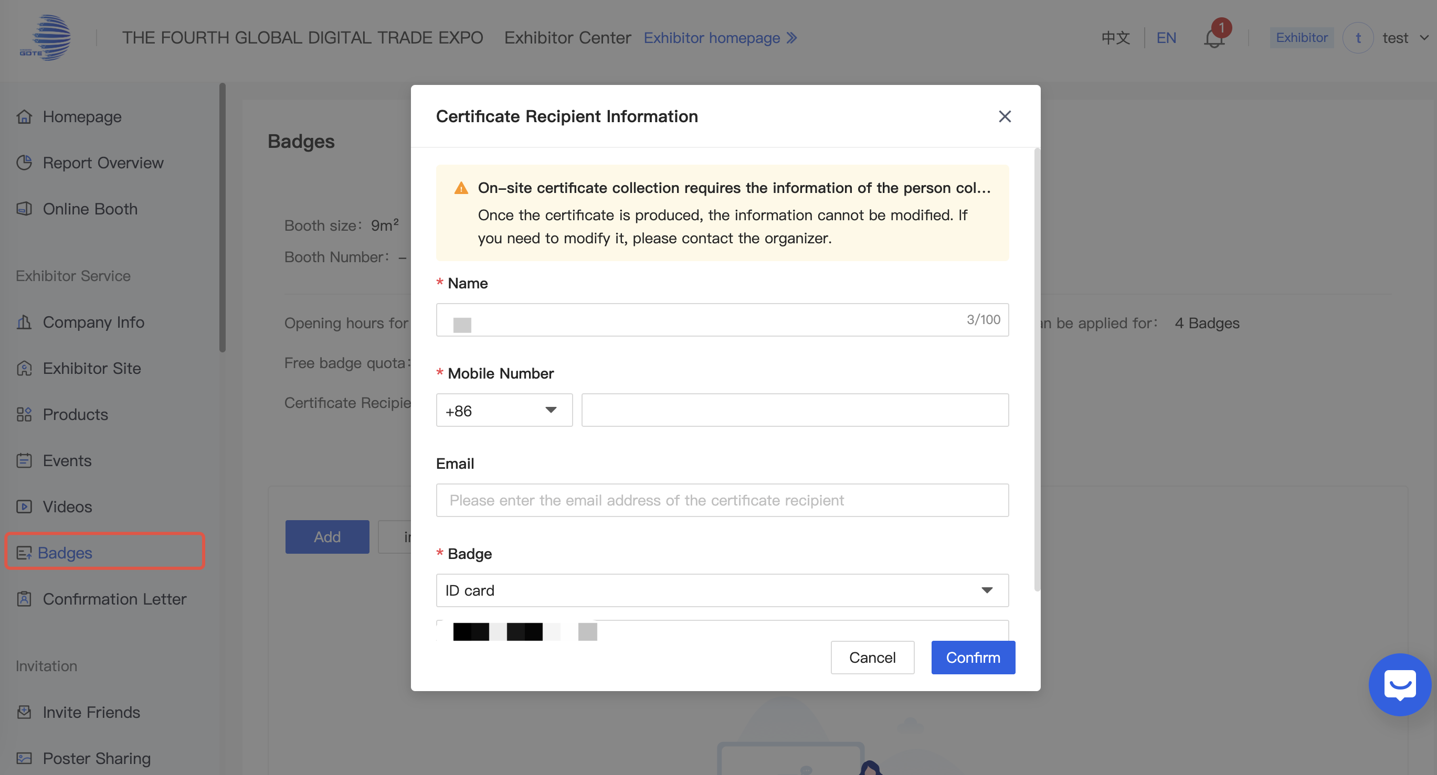
Badges
Click [Badges] to fill in the recipient's information for badge collection.
*On-site certificate collection requires the information of the person collecting the certificate. Please fill in the information of the person collecting the certificate in advance. Once the certificate is produced, the information cannot be modified. If you need to modify it, please contact the organizer.
PC

Slide 16
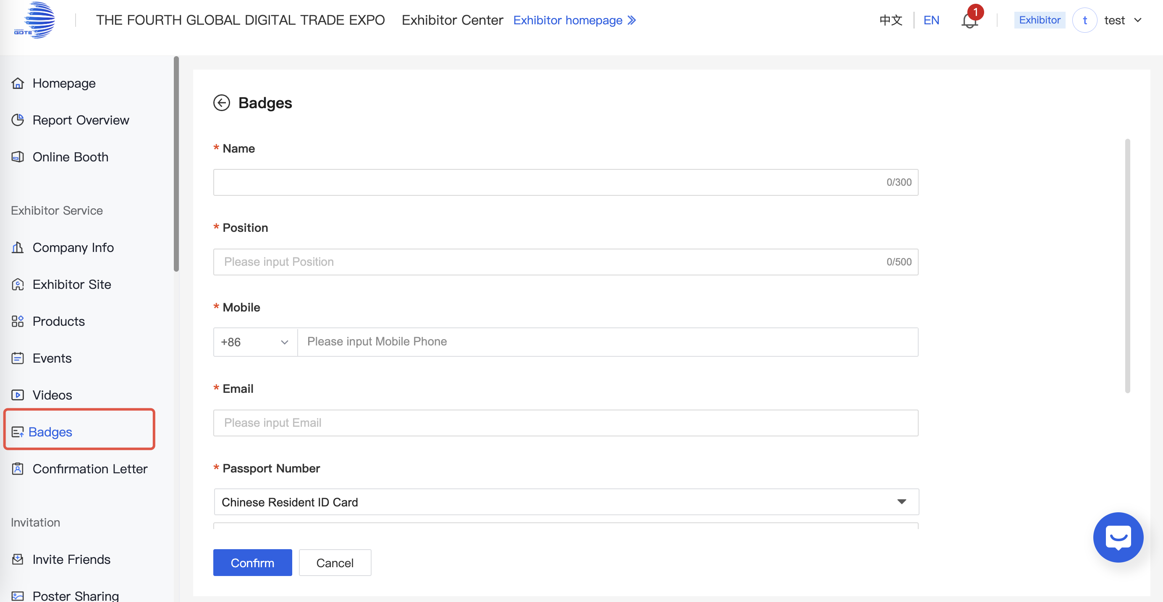
Badges-Add
Complete the applicant's information for the credential, then wait for the review to be completed.
PC

Slide 17
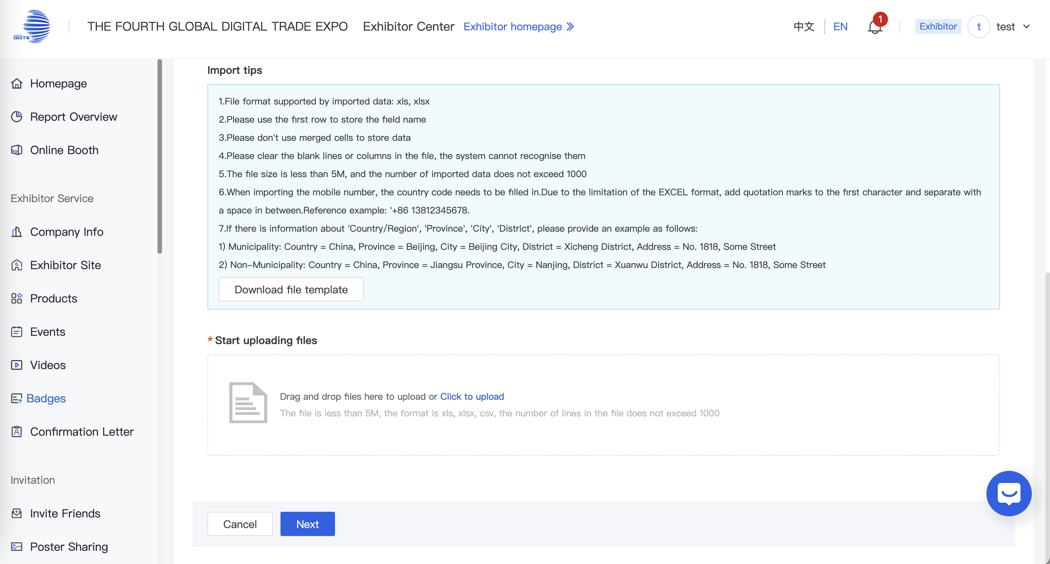
Badges-Import
1.[Download file template]-Enter the personnel details required for badge access-[Umploading Files]
PC

Slide 18
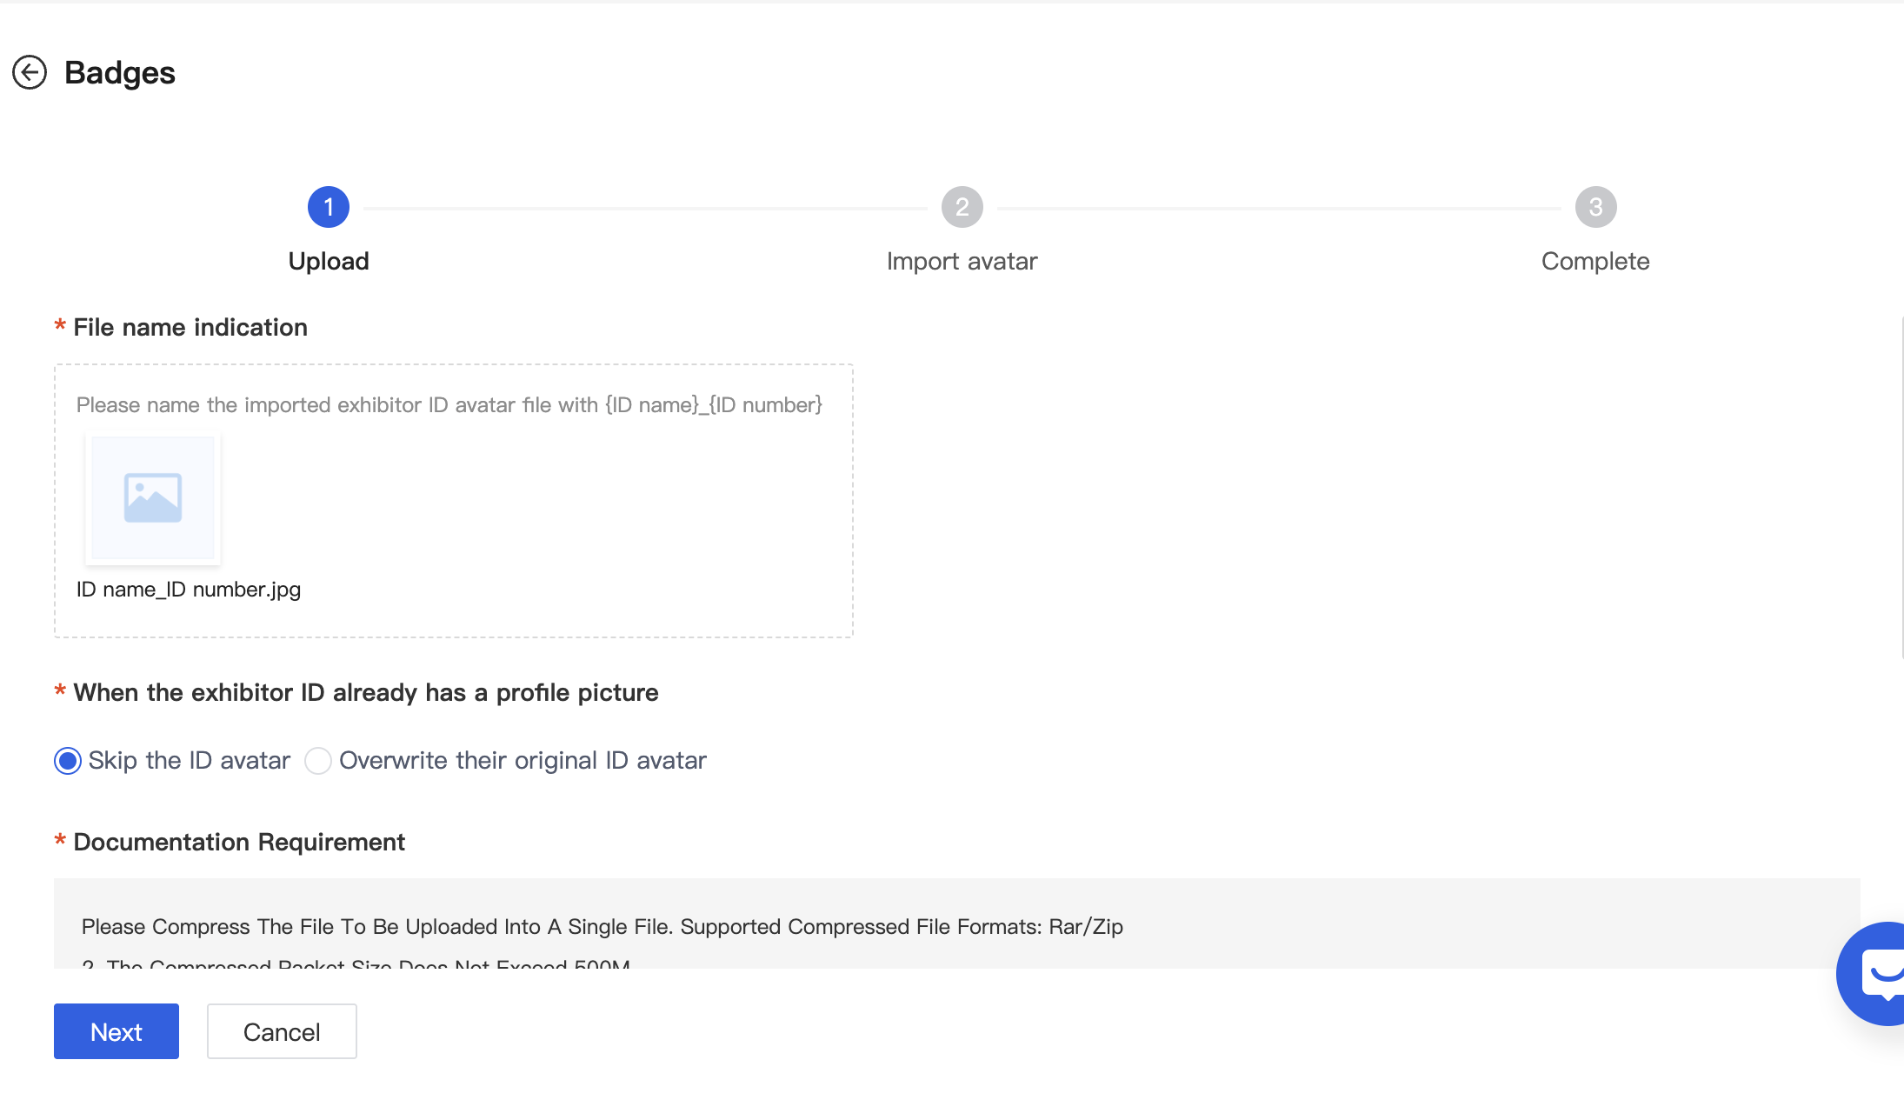
Badges-Import
2.[Import]-[Avatar]
*Please name the imported exhibitor ID avatar file with {ID name}_{ID number}:eg:ID name_ID number.jpg
Please Compress The File To Be Uploaded Into A Single File. Supported Compressed File Formats: Rar/Zip
2. The Compressed Packet Size Does Not Exceed 500M
3. Supported file formats for avatar pictures: jpg/jpeg/png, recommended size: 500*500; please pay attention to whether the format matches the format requirements of the target field before uploading, otherwise it will not work properly after uploading.
4.A single picture should not exceed 2M
Please Correctly Set The Corresponding File Name For The Uploaded File According To The Set Matching Rules
PC

Slide 19
Complete Company Information

Slide 20
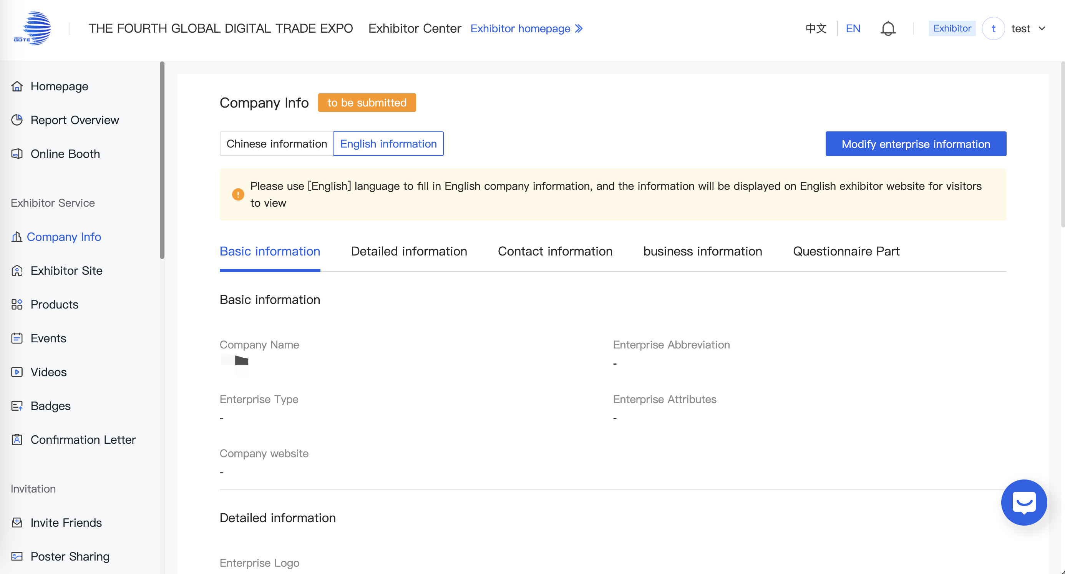
Edit Company Information
Access the Exhibitor Center after approval
Go to [Company Info] → [Modify enterprise Information]
Update the required fields
Click [Save] to finalize changes
PC

Slide 21
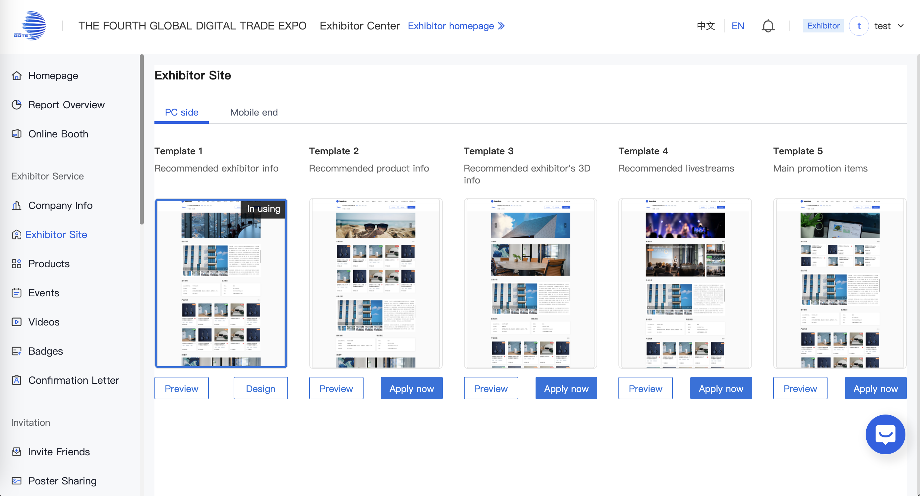
Exhibitor Site
[Exhibitor Site] → [Template Gallery] → [Select Template]
PC

Slide 22
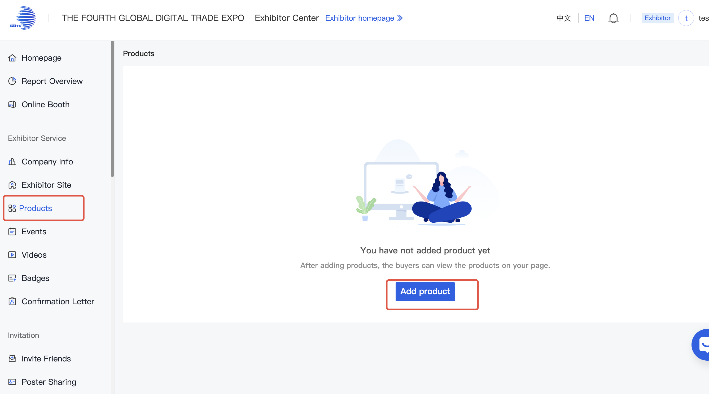
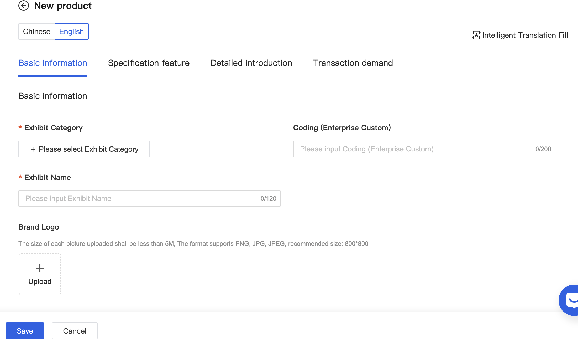
Products
On the [Products] page, you can add products and perform operations such as sorting, editing, and deleting uploaded products.
PC

Slide 23
Personal Information Settings

Slide 24
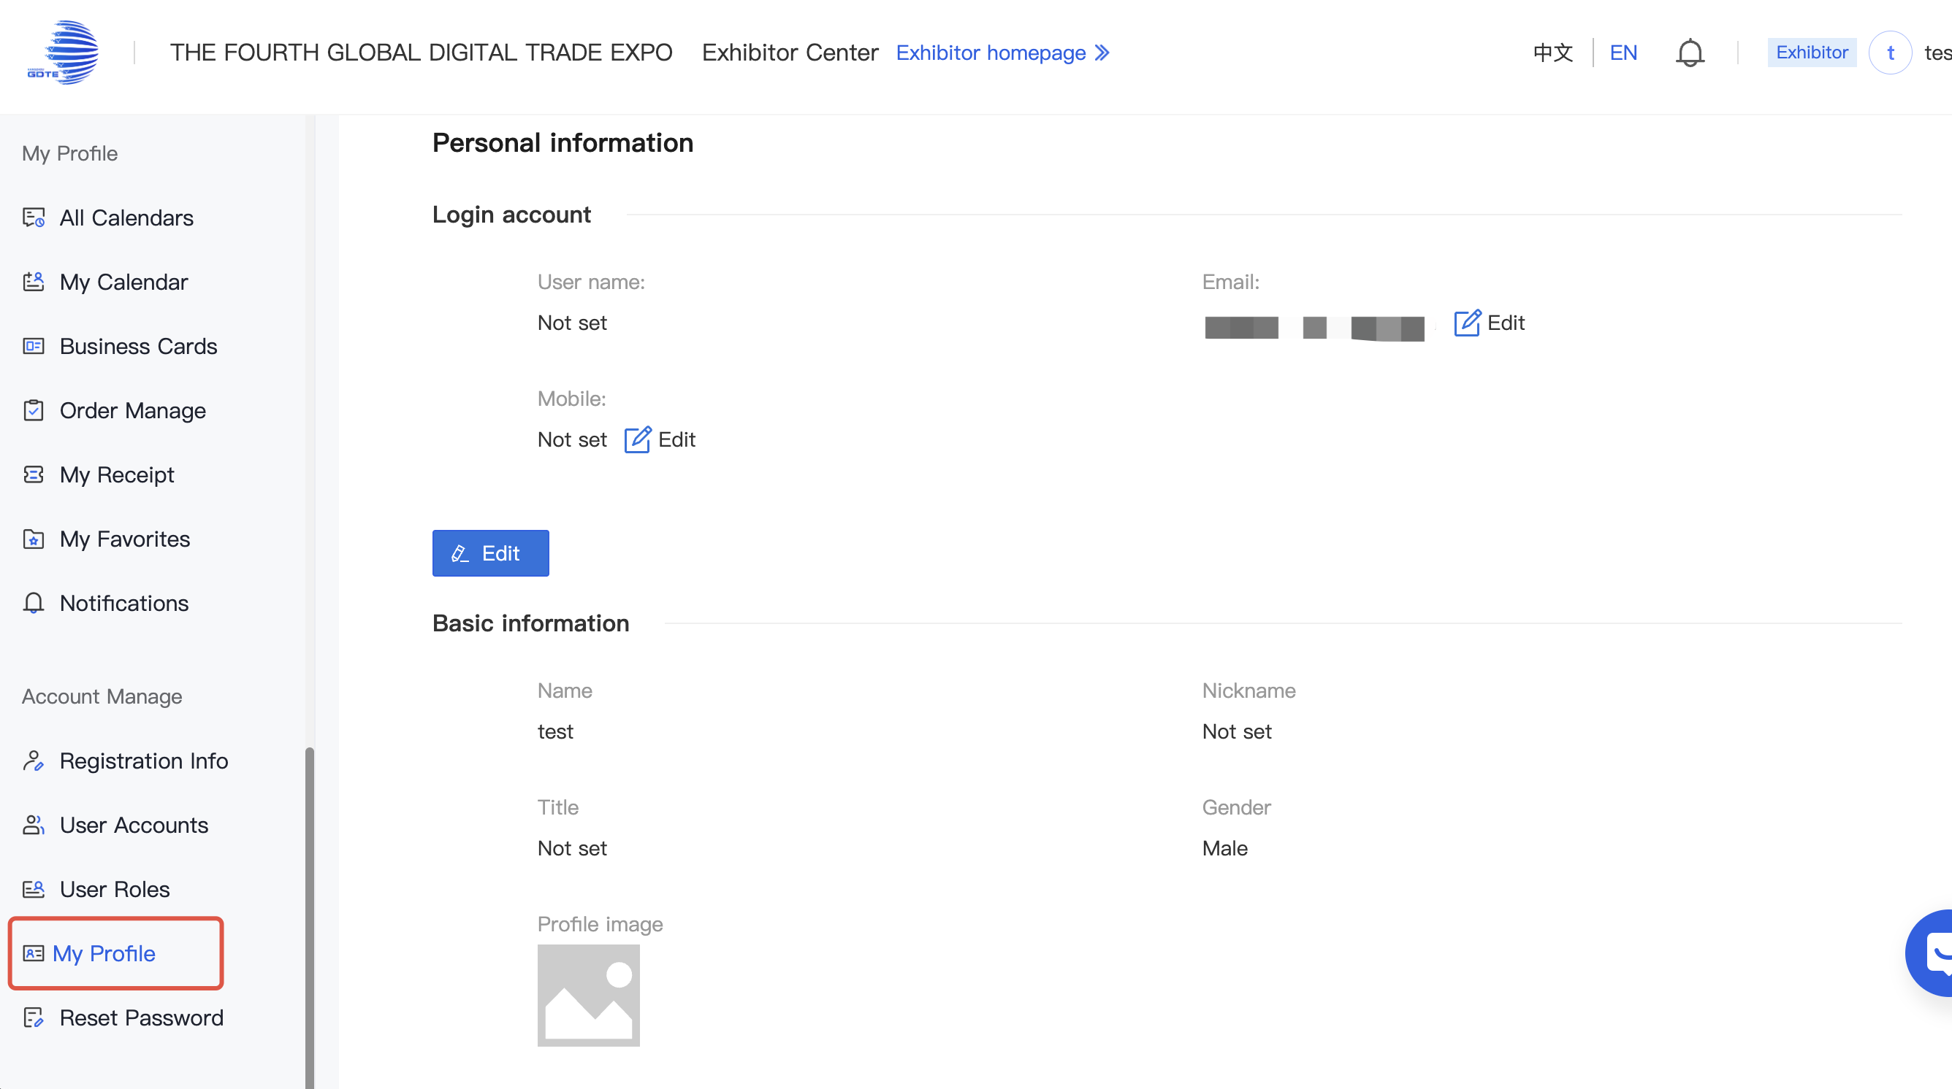
My Profile
On the [My Profile] page, you can modify your registered mobile number, email address, and administrator profile settings.
PC

Slide 25
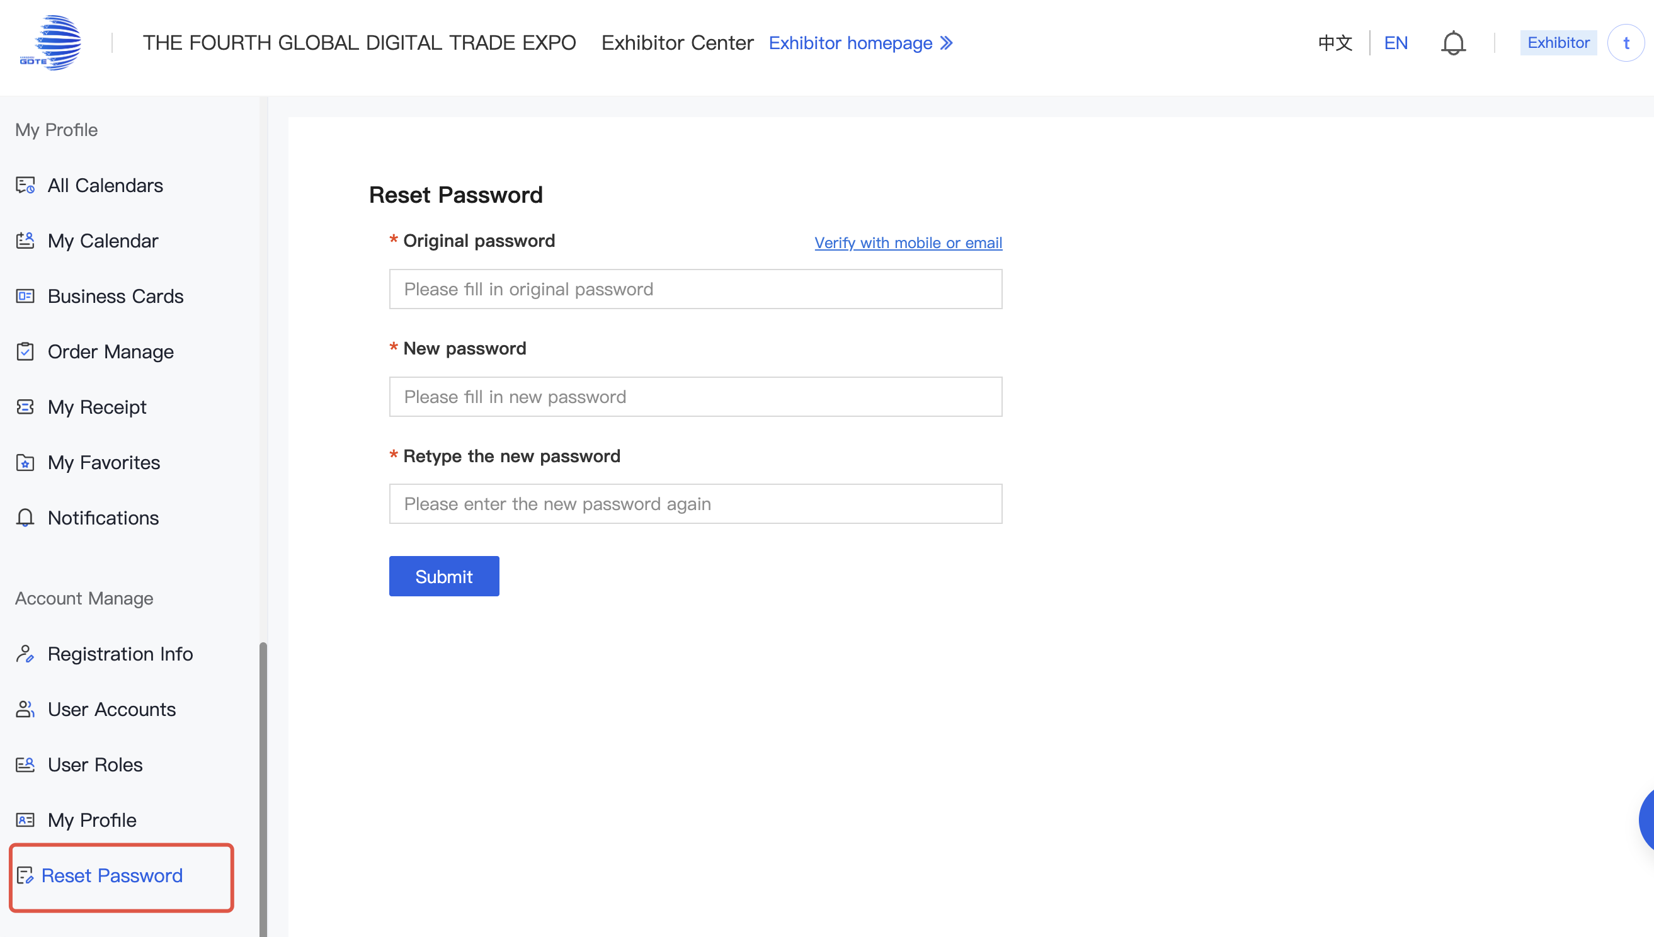
Reset Password
On the [Reset Password] page, you can reset your login password.
PC

Slide 26
THE FOURTH GLOBAL DIGITAL TRADE EXPO
WELCOME!

