Slide 1


The Fifth Global Digital Trade Exppo
Operation Instructions for Professional Visitor Registration
中国，杭州 Hangzhou , China

Slide 2



一、Register & Sign-in

Slide 3

1、Visit the Digital Trade Online website.
Click **Sign‑in** at the top‑right corner,https://www.gdteonline.com/zh/,or click **Register** for professional visitors in the middle of the page.
Alternatively, search for the *Global Digital Trade Expo Mini Program* via WeChat or Alipay, then select **Visitor** to complete registration.

Slide 4
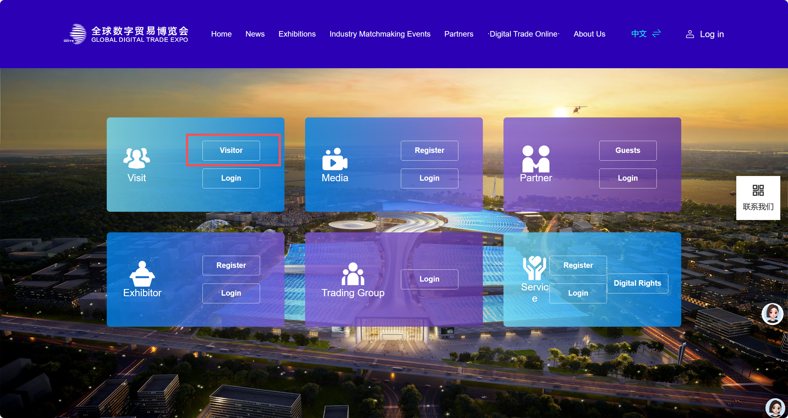
2.Go to Registration Entry
Click **Professional Visitor** and select **Visitor Registration**.

Slide 5
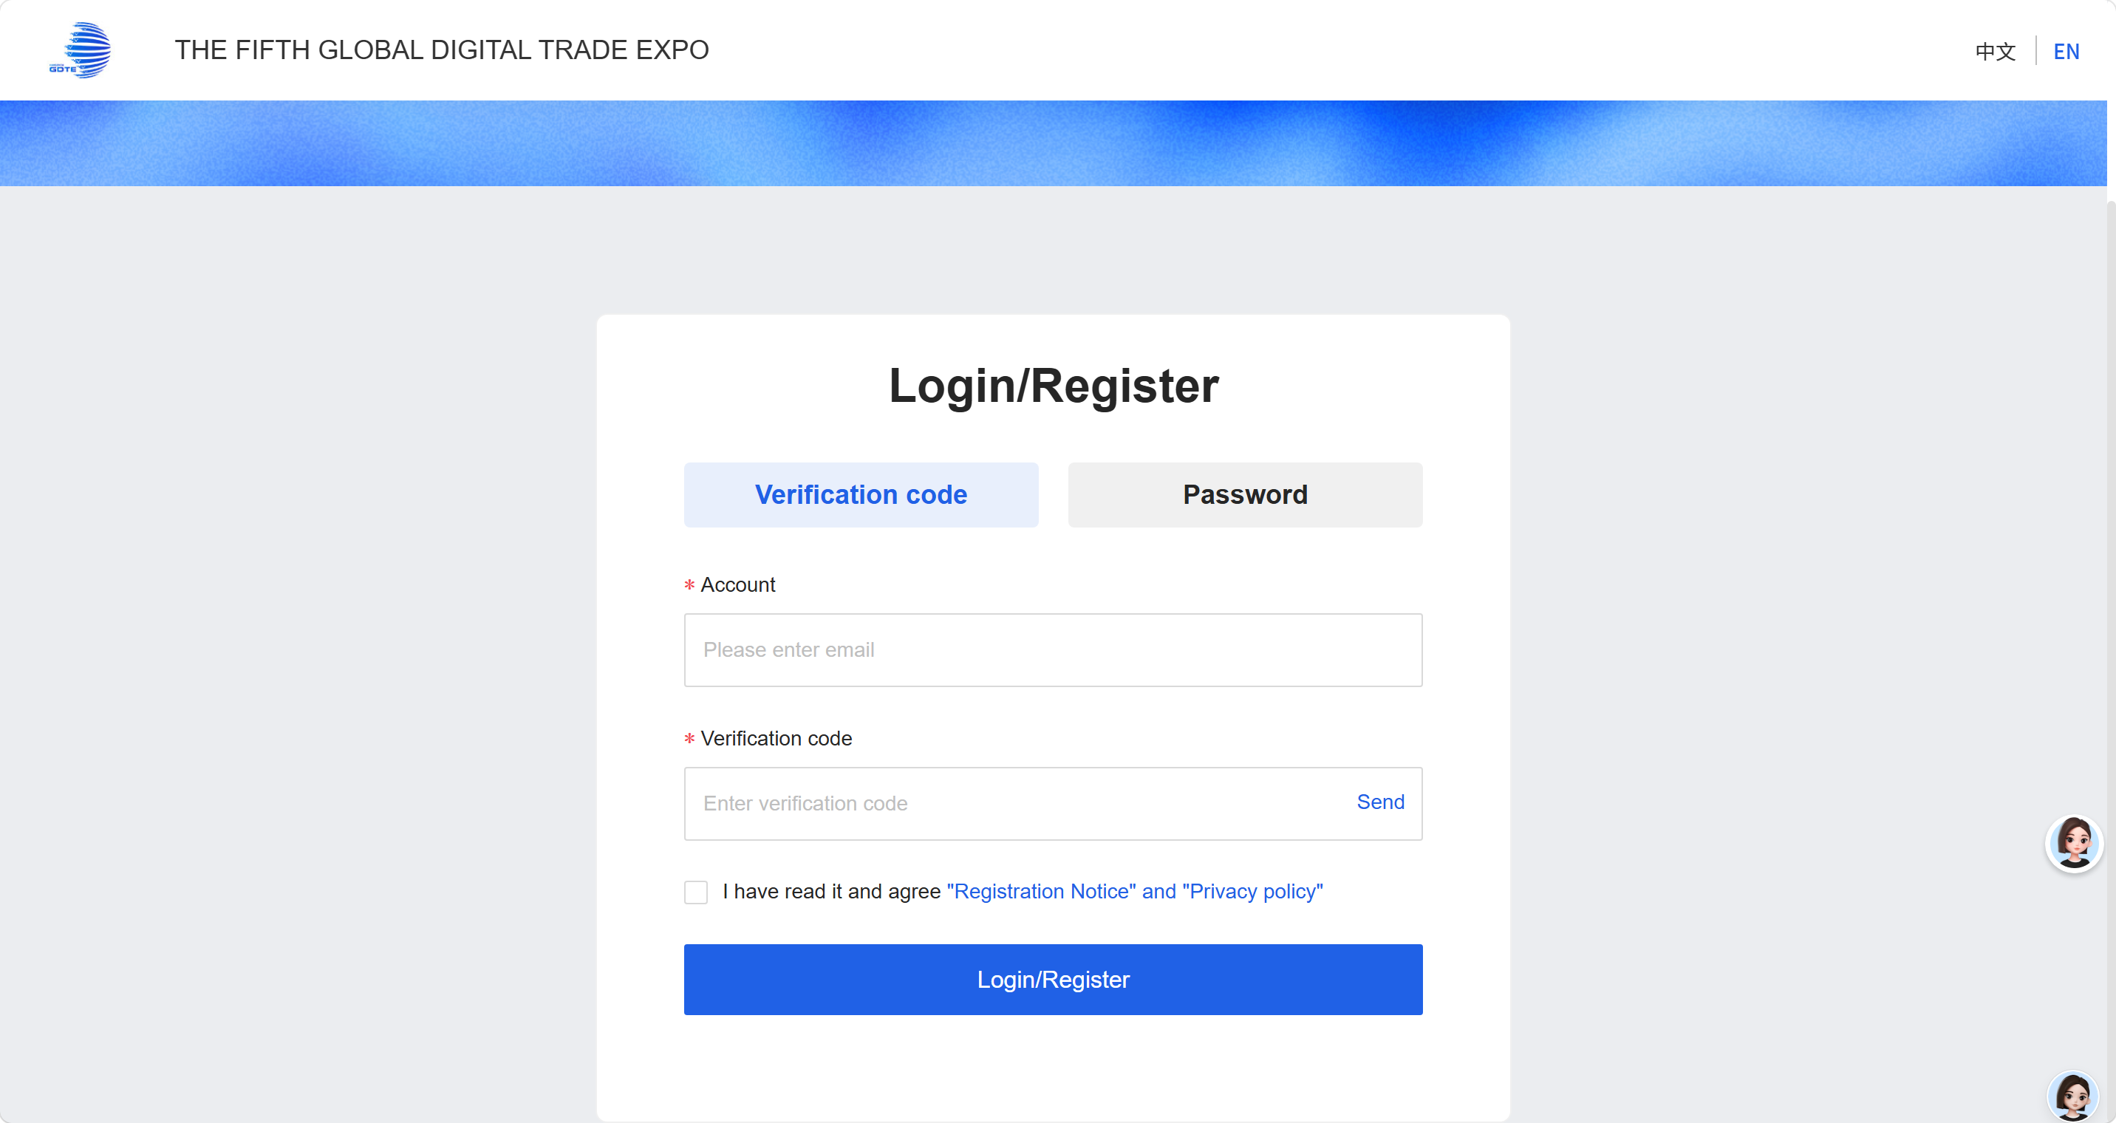

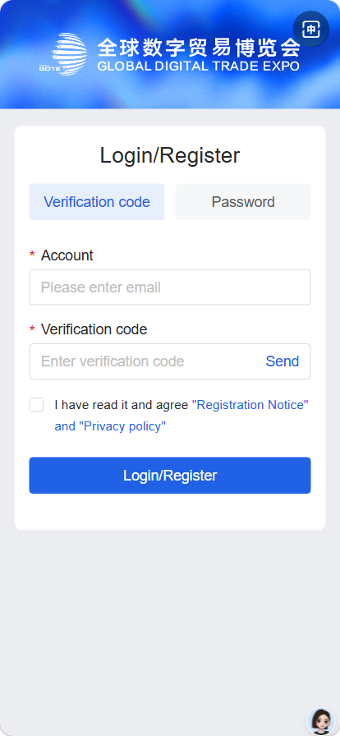
3.Register & Sign-in
Enter your mobile phone number or email address as your account, obtain the verification code to complete registration and sign‑in.

Slide 6
二、Fill in your information

Slide 7
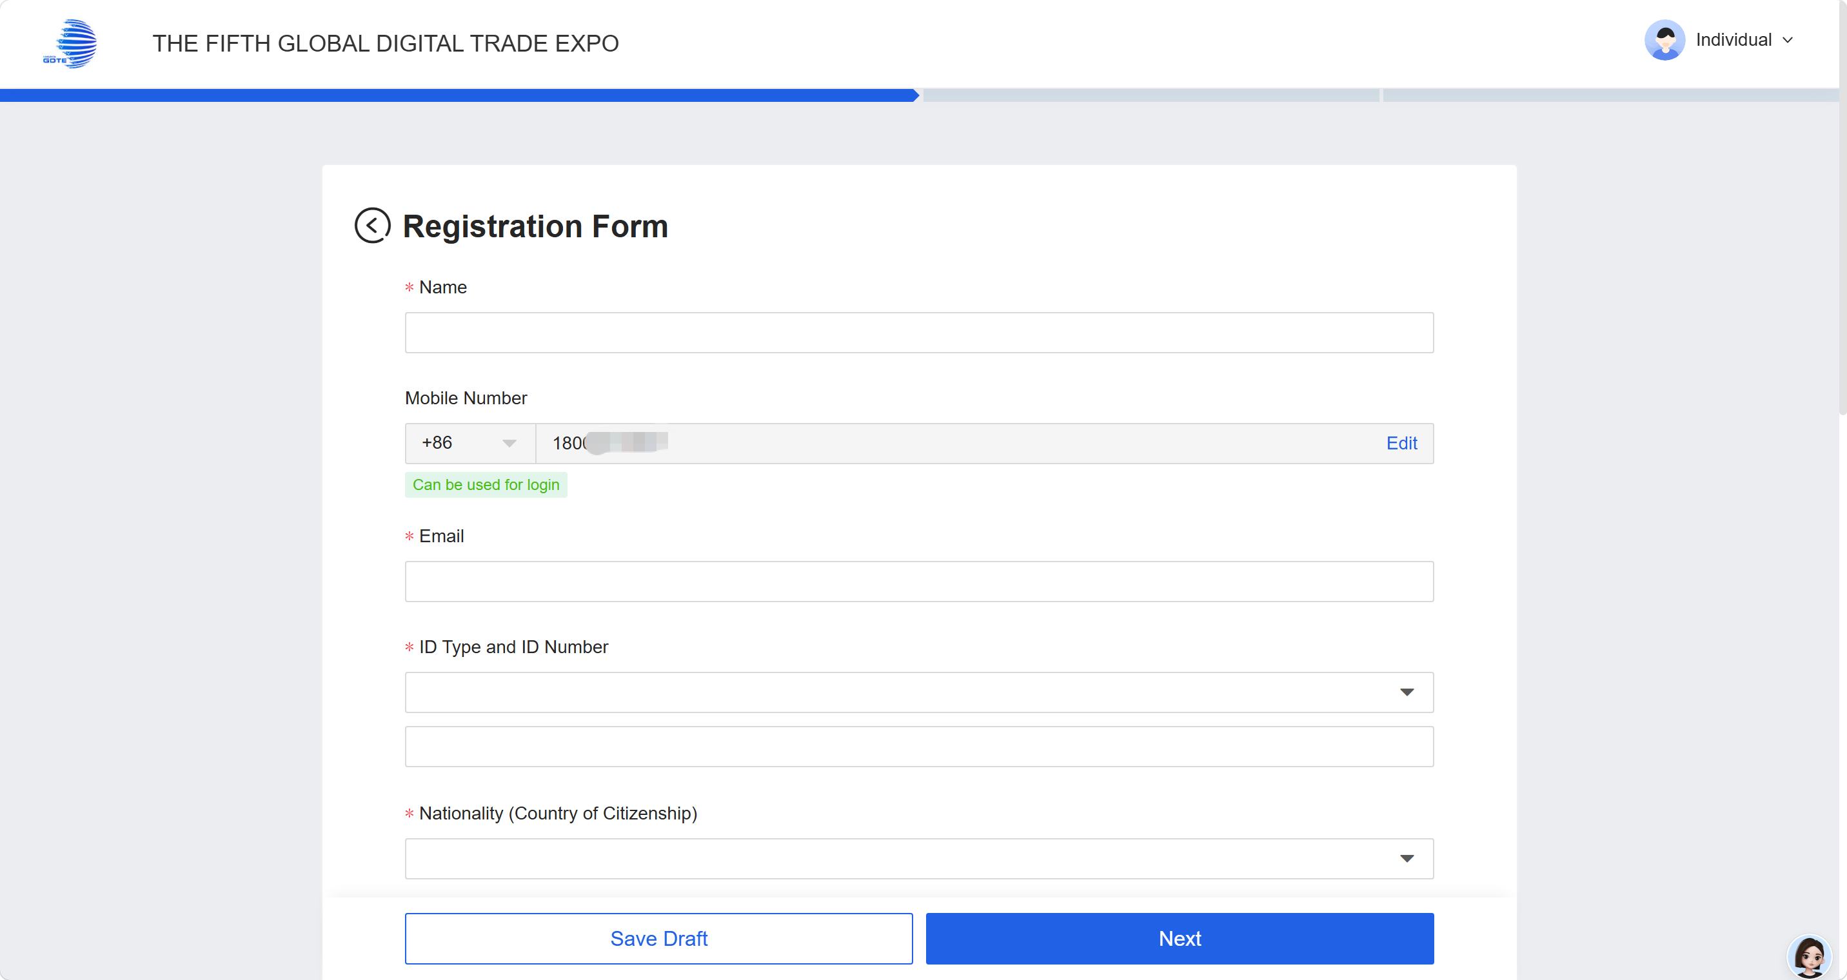
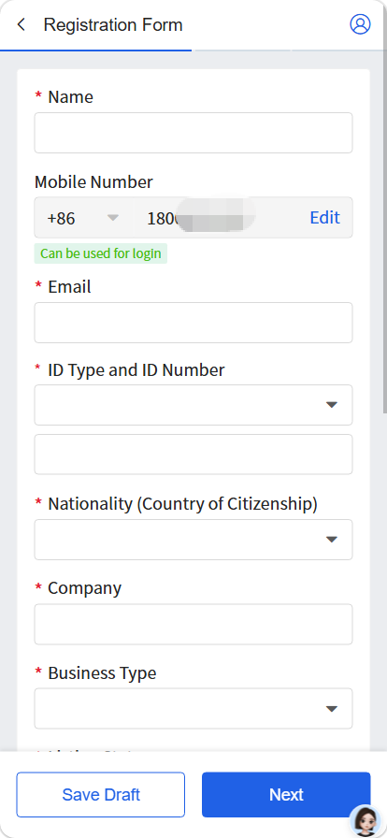
1.Fill in your registration information
Fill in your registration information
> Note: Please enter your company’s registered legal name. The system will display dropdown suggestions during input; select the matching name for auto‑fill. If your company name is not available in the dropdown list, click **Manual Entry** in the prompt below to input it manually.
> Please fill in your name, ID type, ID number and profile photo according to the information shown on your identity document.
报名表单

Slide 8
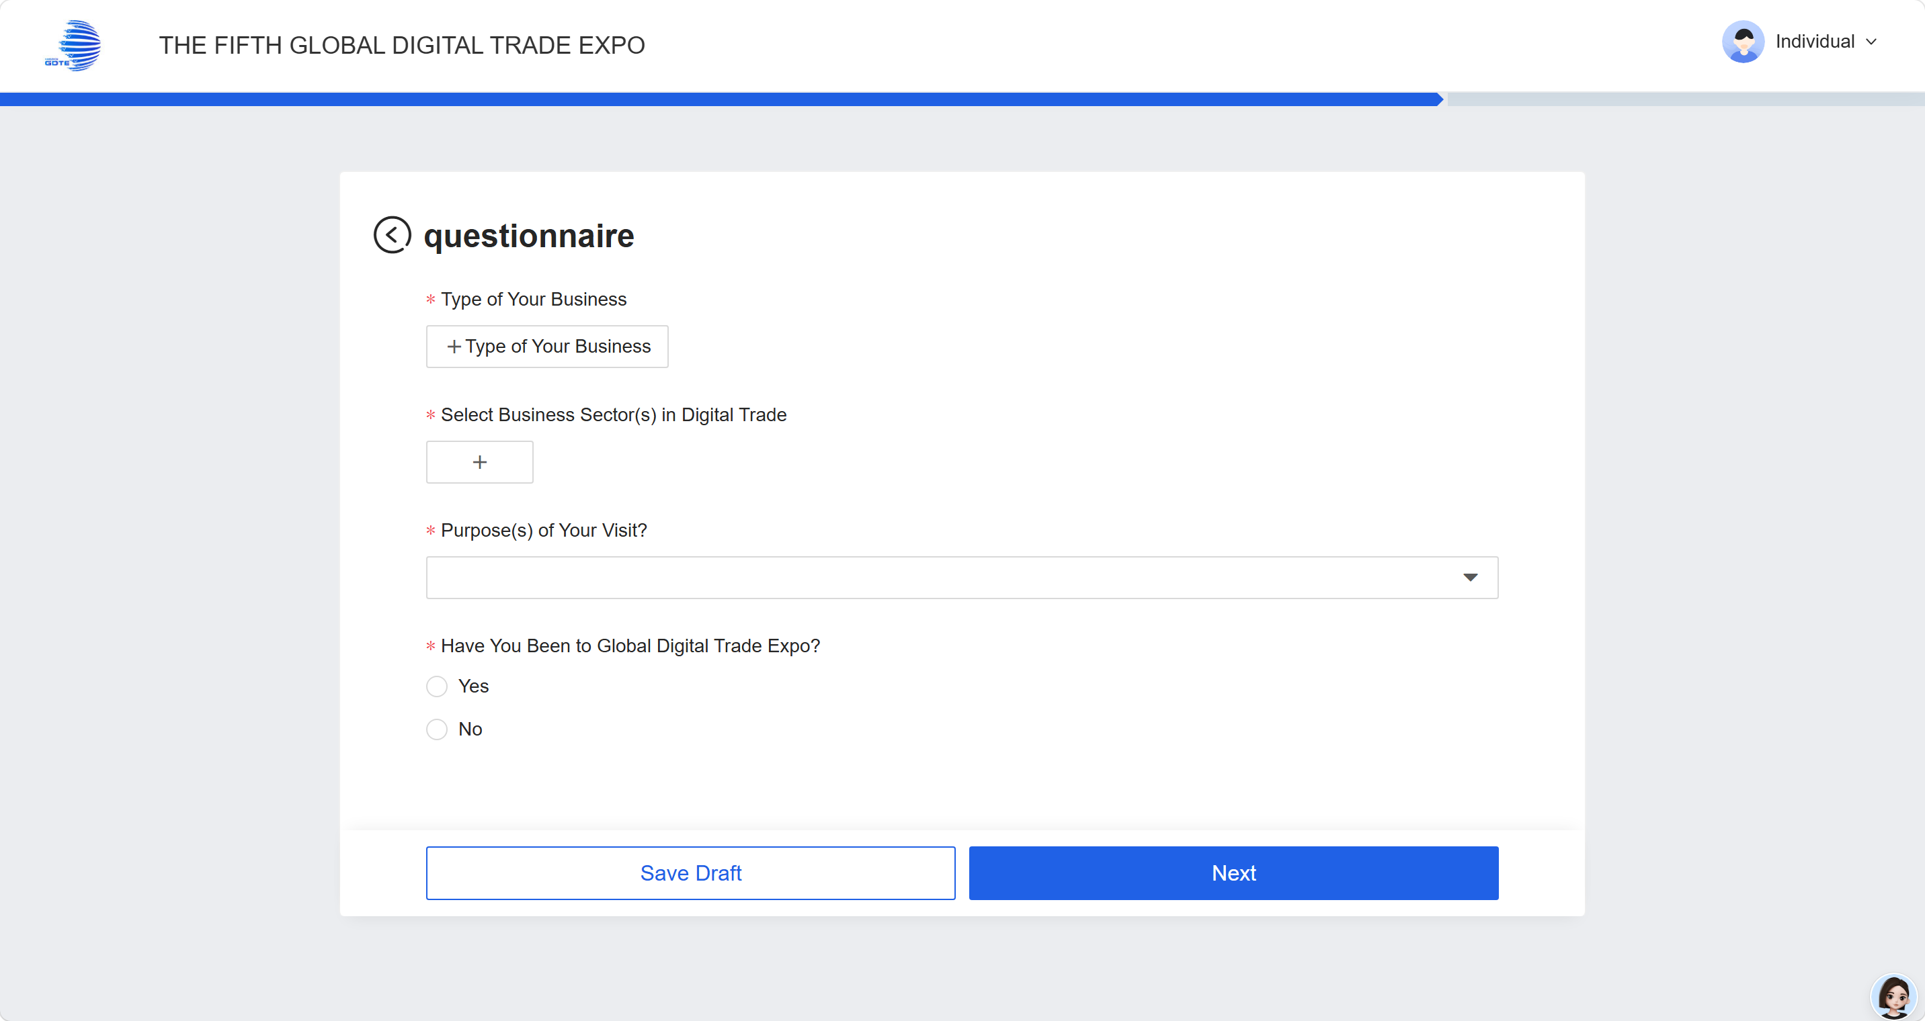
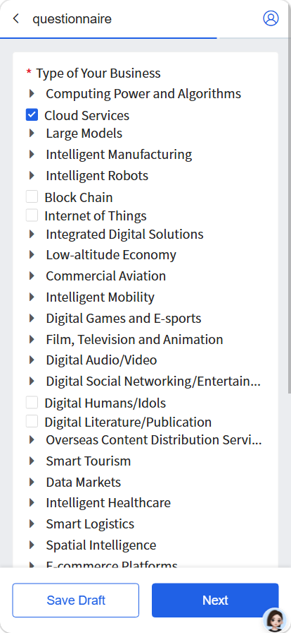
2.Fill in the questionnaire information
Fill in the questionnaire information，Click **Next**

Slide 9
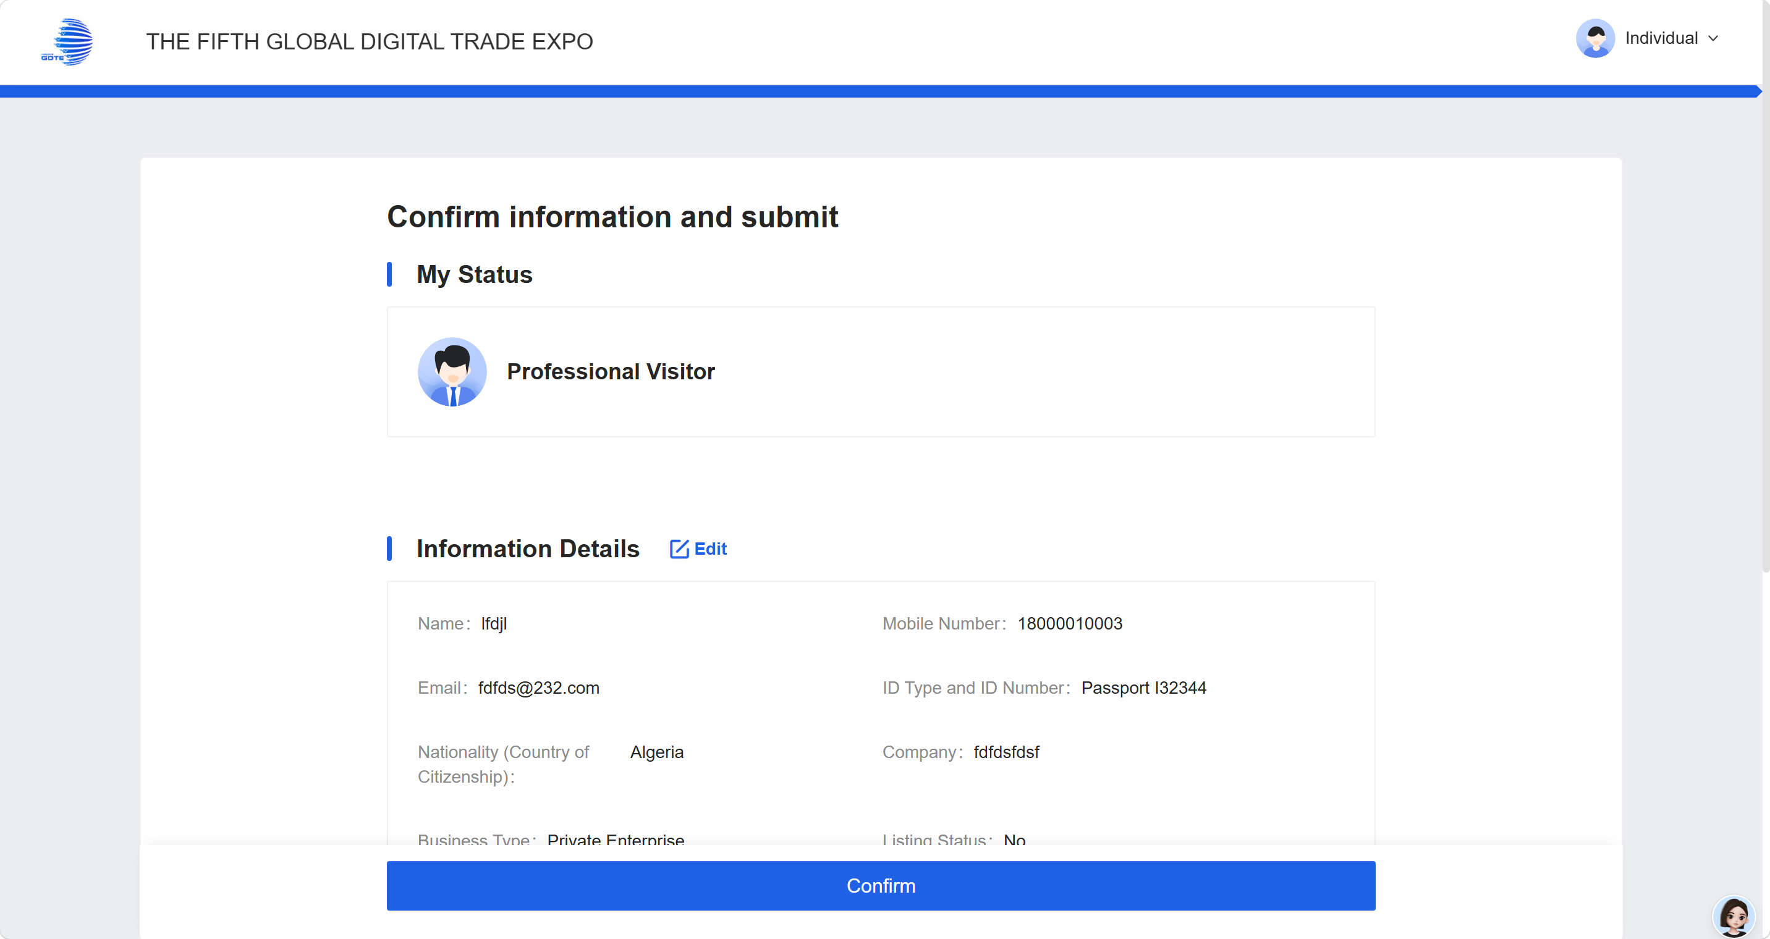
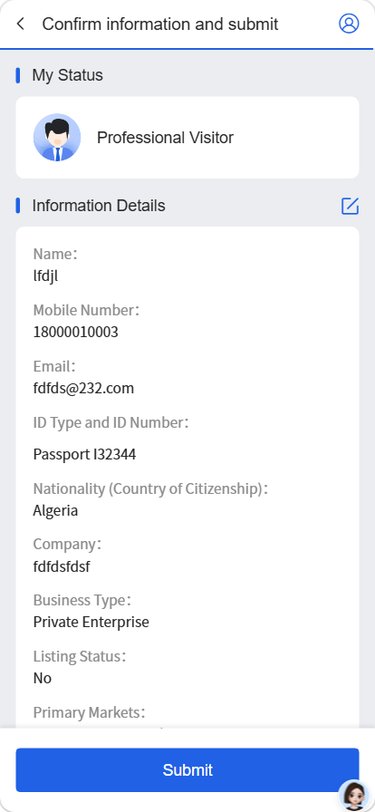
3.Comfirm
Re‑check your information. If all details are correct, click **Confirm and Submit**.

Slide 10
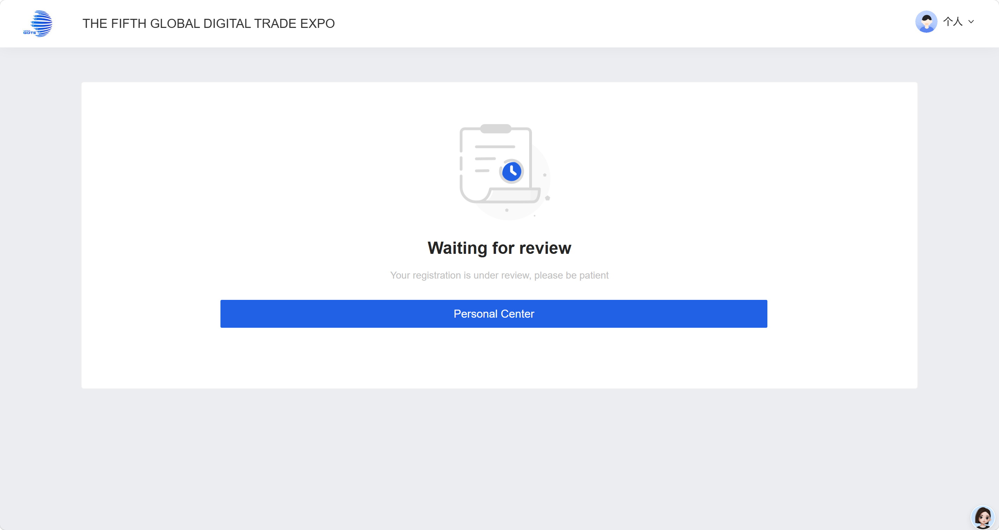
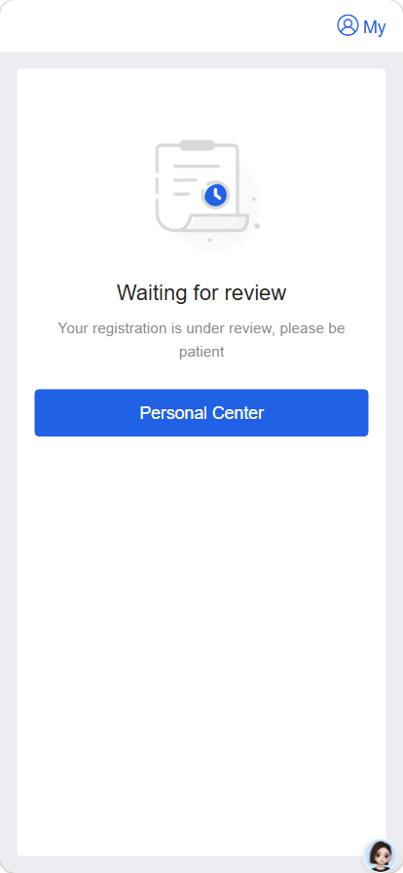
4.waiting for review
Wait for organizer’s review after information submission.
You may view your review status by accessing the Personal Center, or log in as a visitor on the website to enter the Personal Center.

Slide 11
THANKS

