Slide 1


THE FIFTH GLOBAL DIGITAL TRADE EXPO
​​Exhibitor Registration Instructions
中国·杭州 Hangzhou , China

Slide 2


Official Website
​​Visit the official conference website​​:
https://online.gdteonline.com/en/ → Click ​​"Digital Trade Online"​​ in the navigation bar.
PC
Mini Program

Slide 3

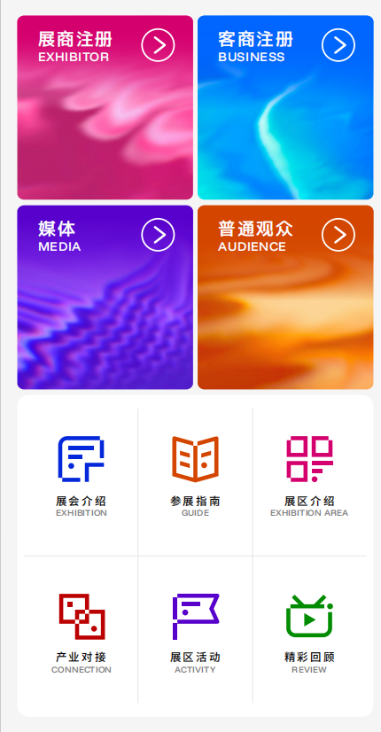
Exhibitor Registration
​​Click [Exhibitor Registration] on the website, or tap [Exhibit Application] in the mini-program to complete your registration.
PC
Mini Program/H5

Slide 4
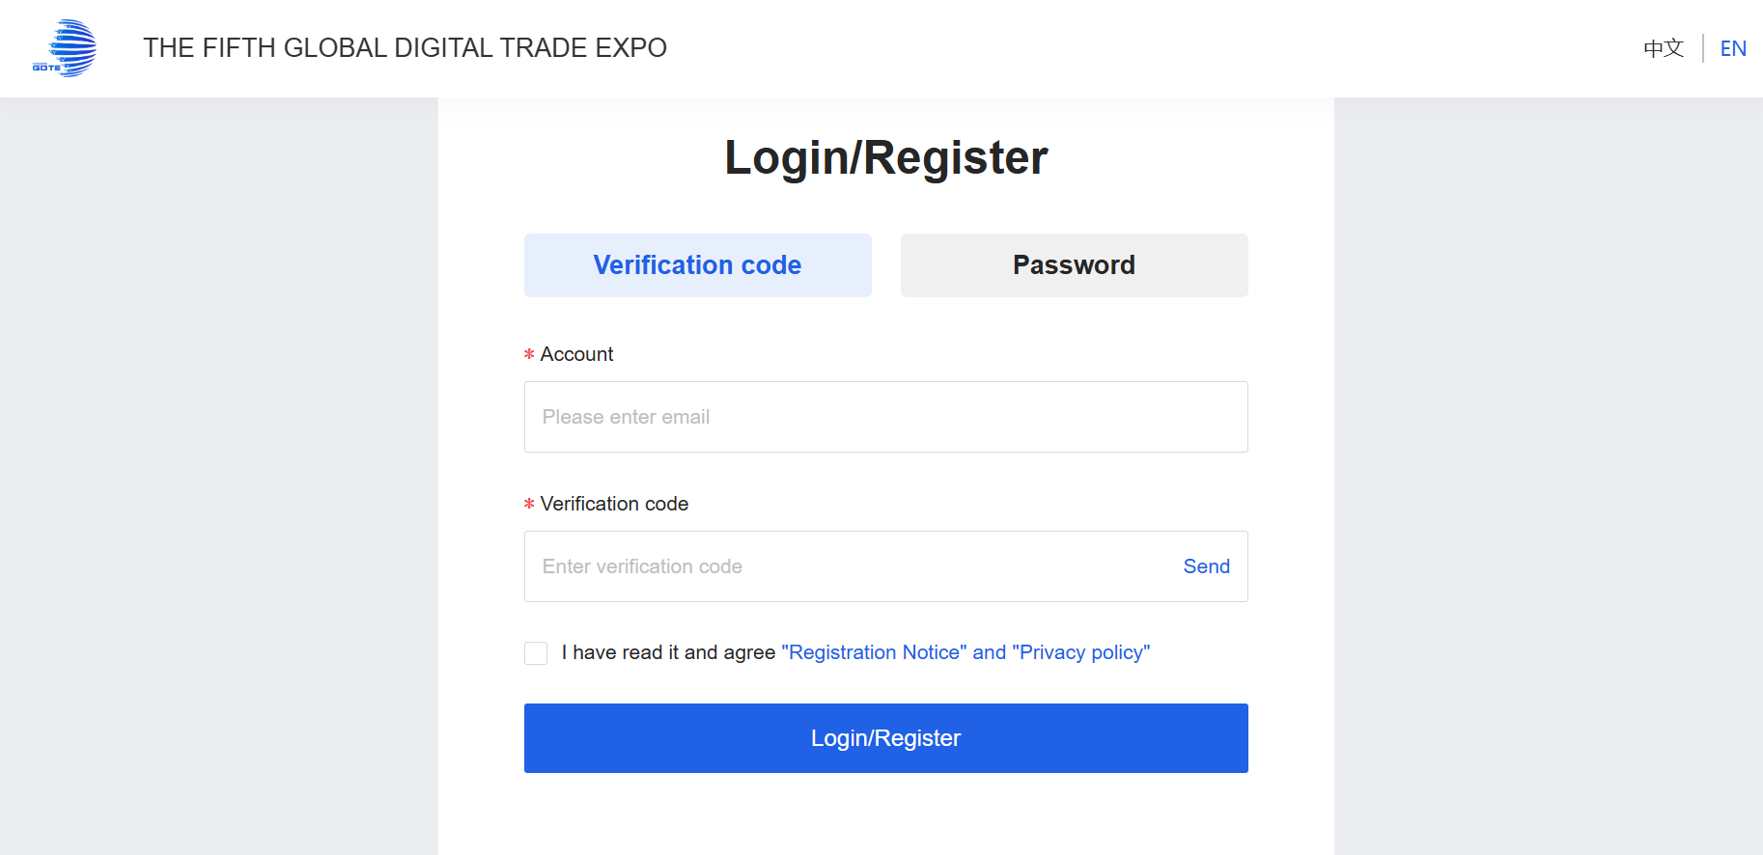
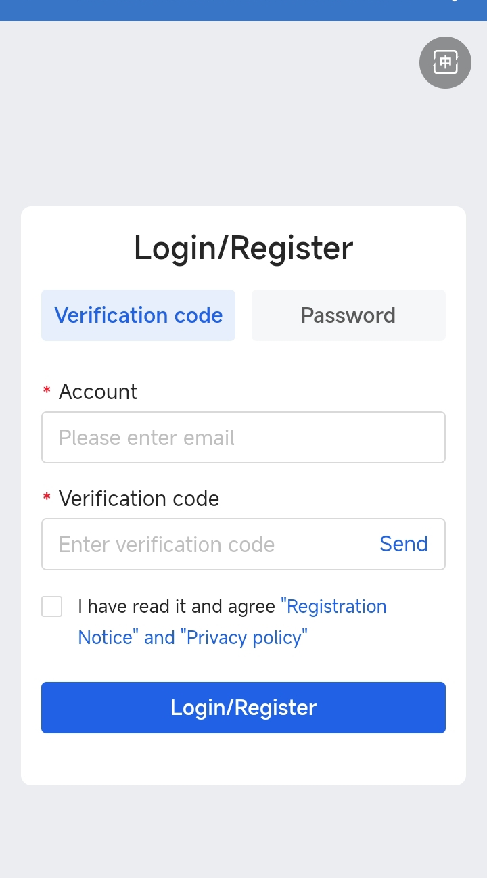
Exhibitor Registration
Enter your mobile number or email address, then obtain the verification code to register/log in to your account.
PC/H5
Mini Program/H5

Slide 5
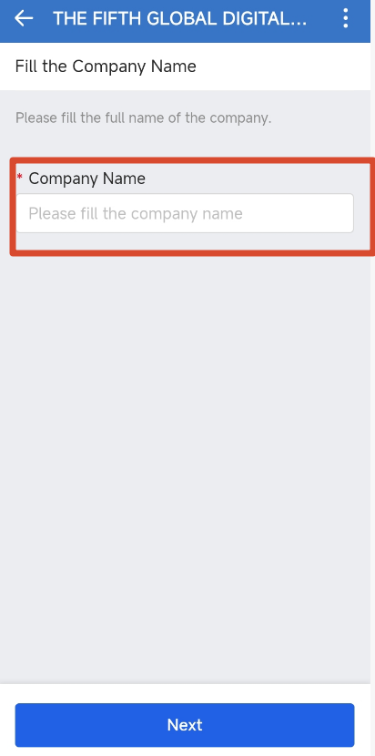
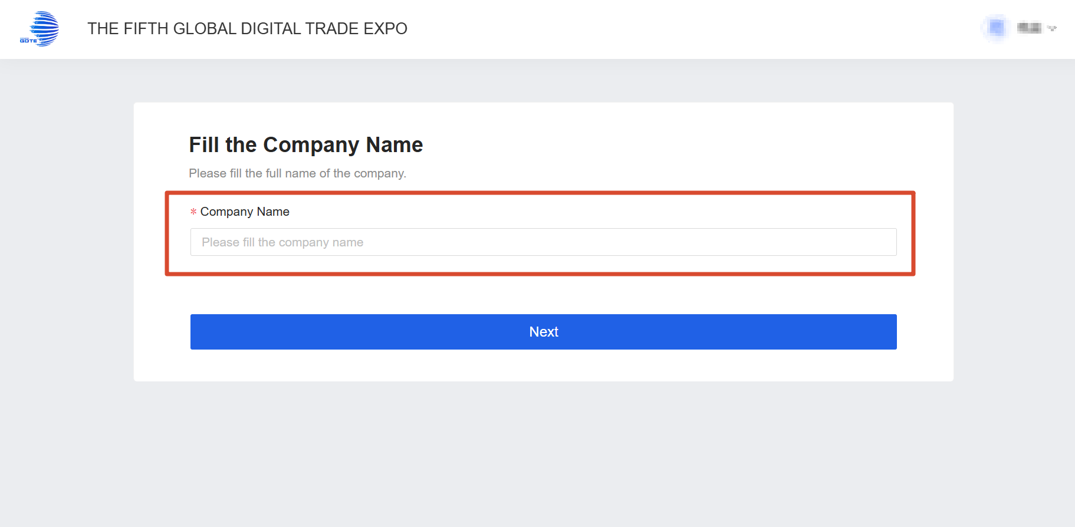
Exhibitor Registration
Please enter your company name and click [Next].
*The [Company Name] field is your publicly displayed name. Please enter it carefully, as this field is unique—once a company name has been registered, it cannot be used again by another account.
PC/H5
Mini Program/H5

Slide 6
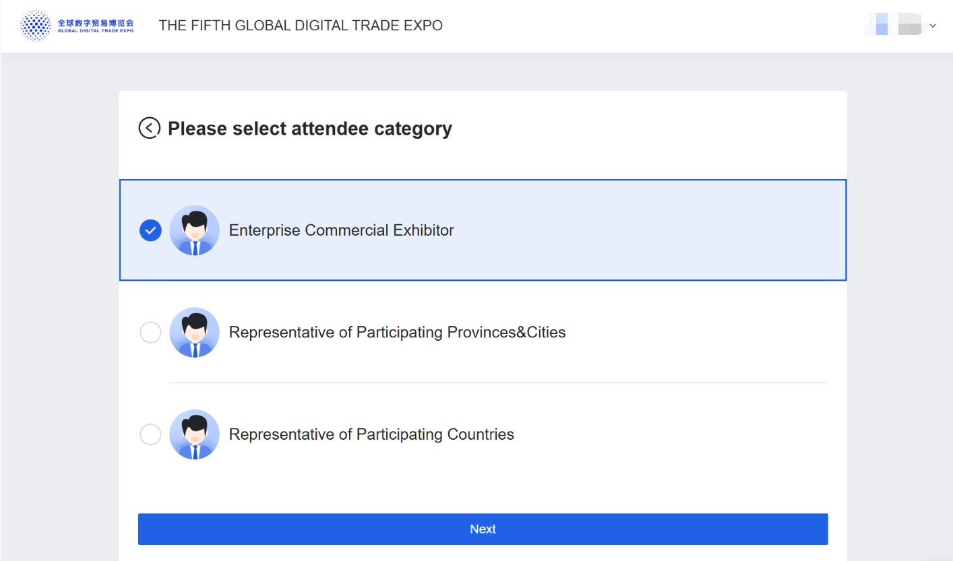
Exhibitor Registration
Select population category.

Slide 7
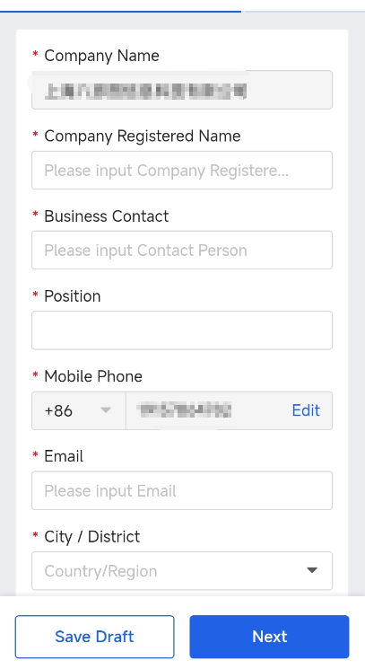
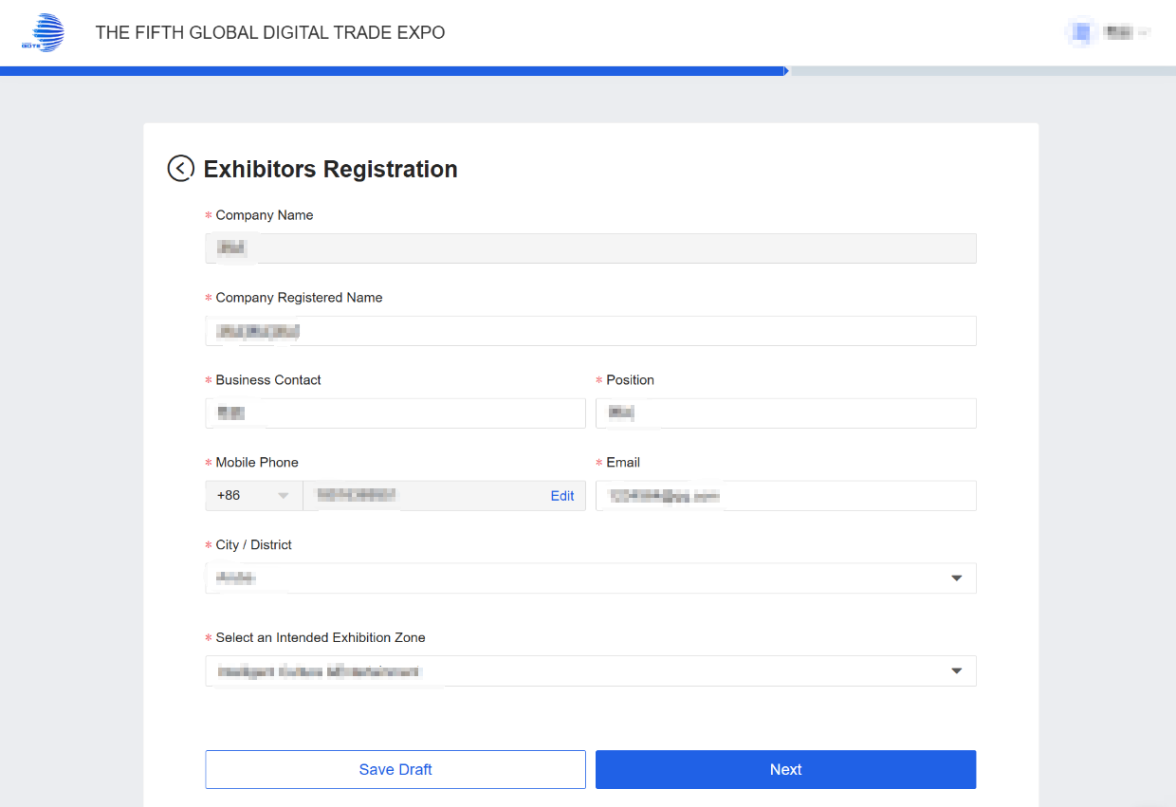
Exhibitor Registration
Please complete the exhibitor's company registration information and click [Next].
【Mobile Phone】When registering with your email, the phone number entered will only function as a contact method and cannot be used to log in.
【City/District】 Please specify the city of your company's headquarters.
PC/H5
Mini Program/H5

Slide 8
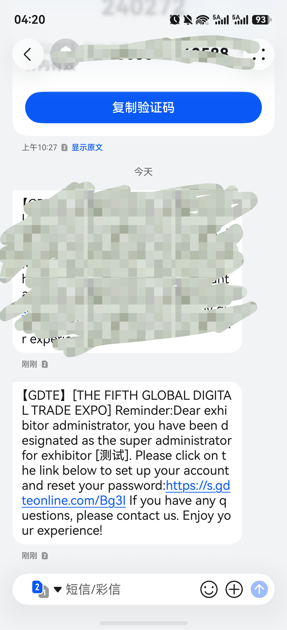
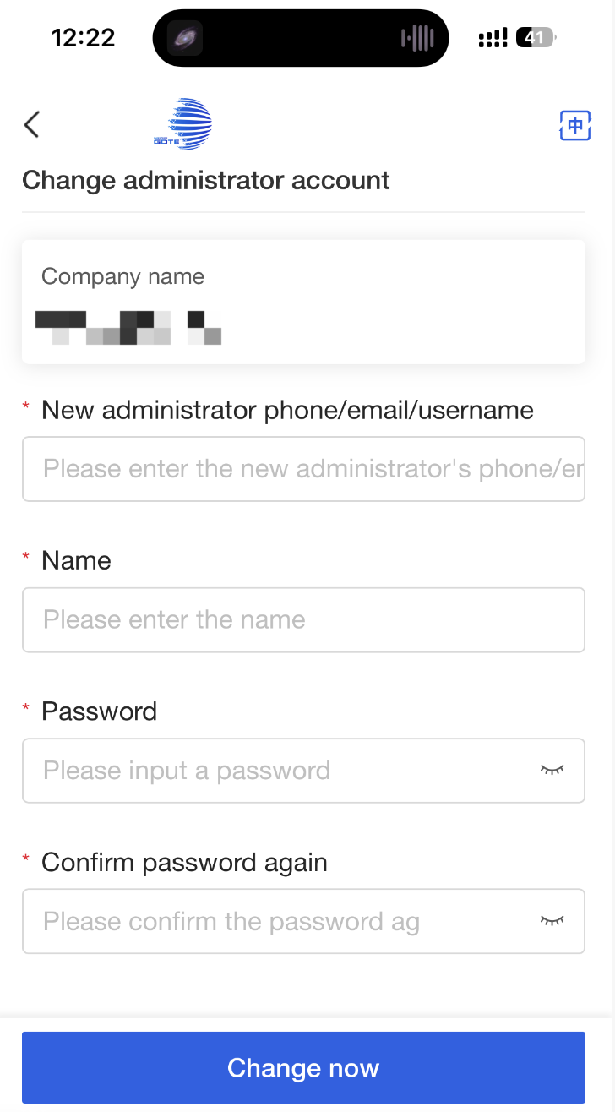
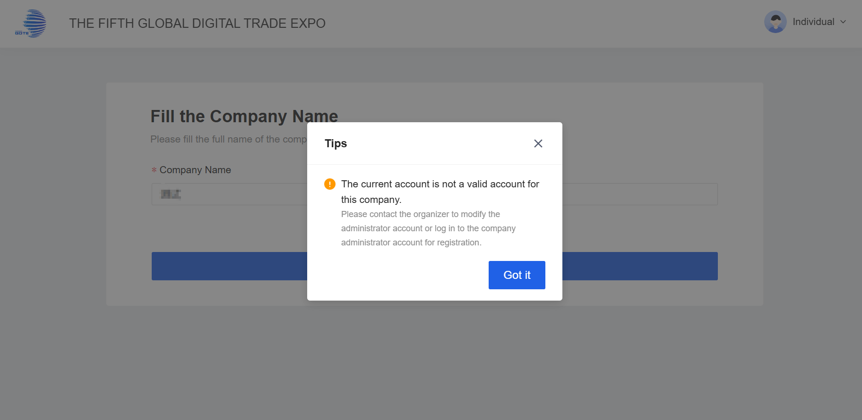
Exhibitor Registration
Contact your pavilion manager → Receive SMS link → Bind new number → Continue registration.
Contact your pavilion manager for assistance.
Check your SMS for the verification link after the update.
Follow the link to bind your new mobile number.
Return to the website to complete registration.
PC
Message/Email
Mini Program/H5

Slide 9
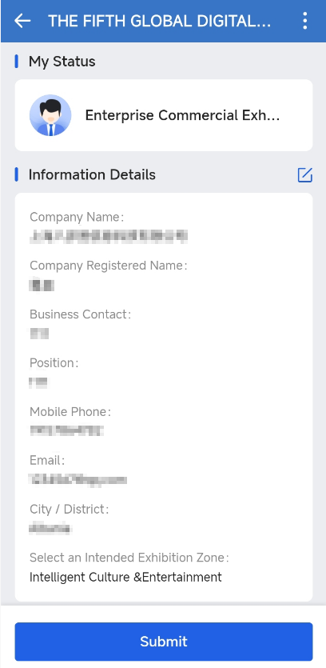
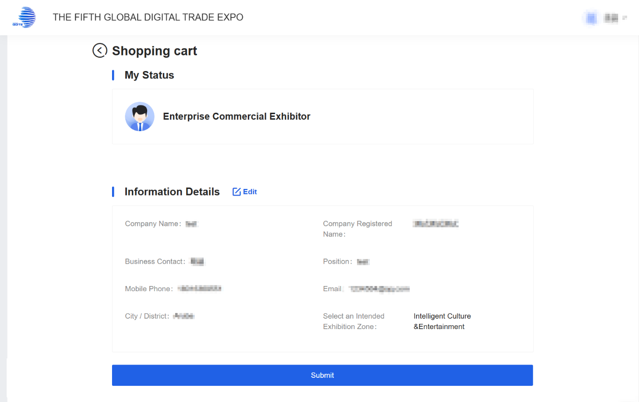
Exhibitor Registration
Before proceeding, please:
Thoroughly review all entered information
Click [Edit] to correct any inaccuracies
Click [Confirm Submission] to finalize and send for review
PC
Mini Program/H5

Slide 10
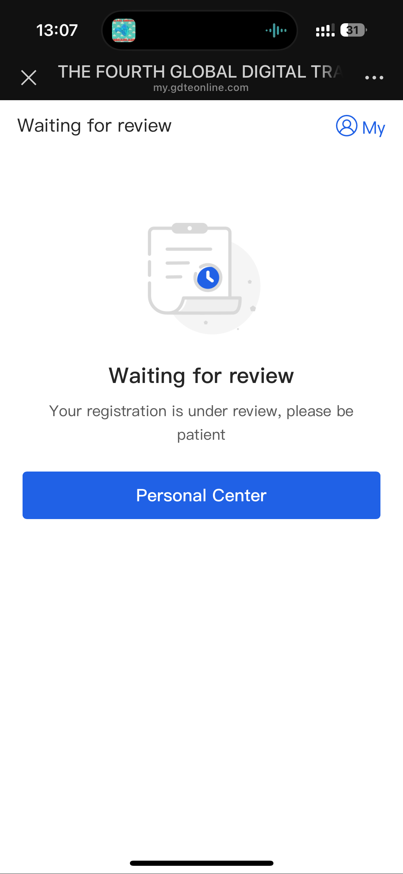
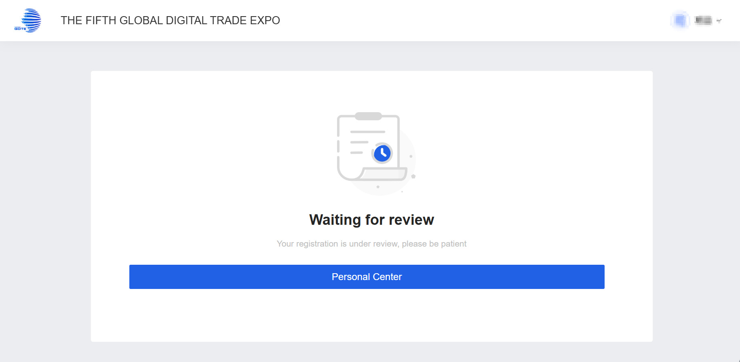
Exhibitor Registration
Next Steps After Submission:
1.Access your submission status anytime through:
2. [Personal Center] in the app, or
3. Exhibitor Login portal (mobile verification code or password required) on our website.
PC
Mini Program/H5

Slide 11
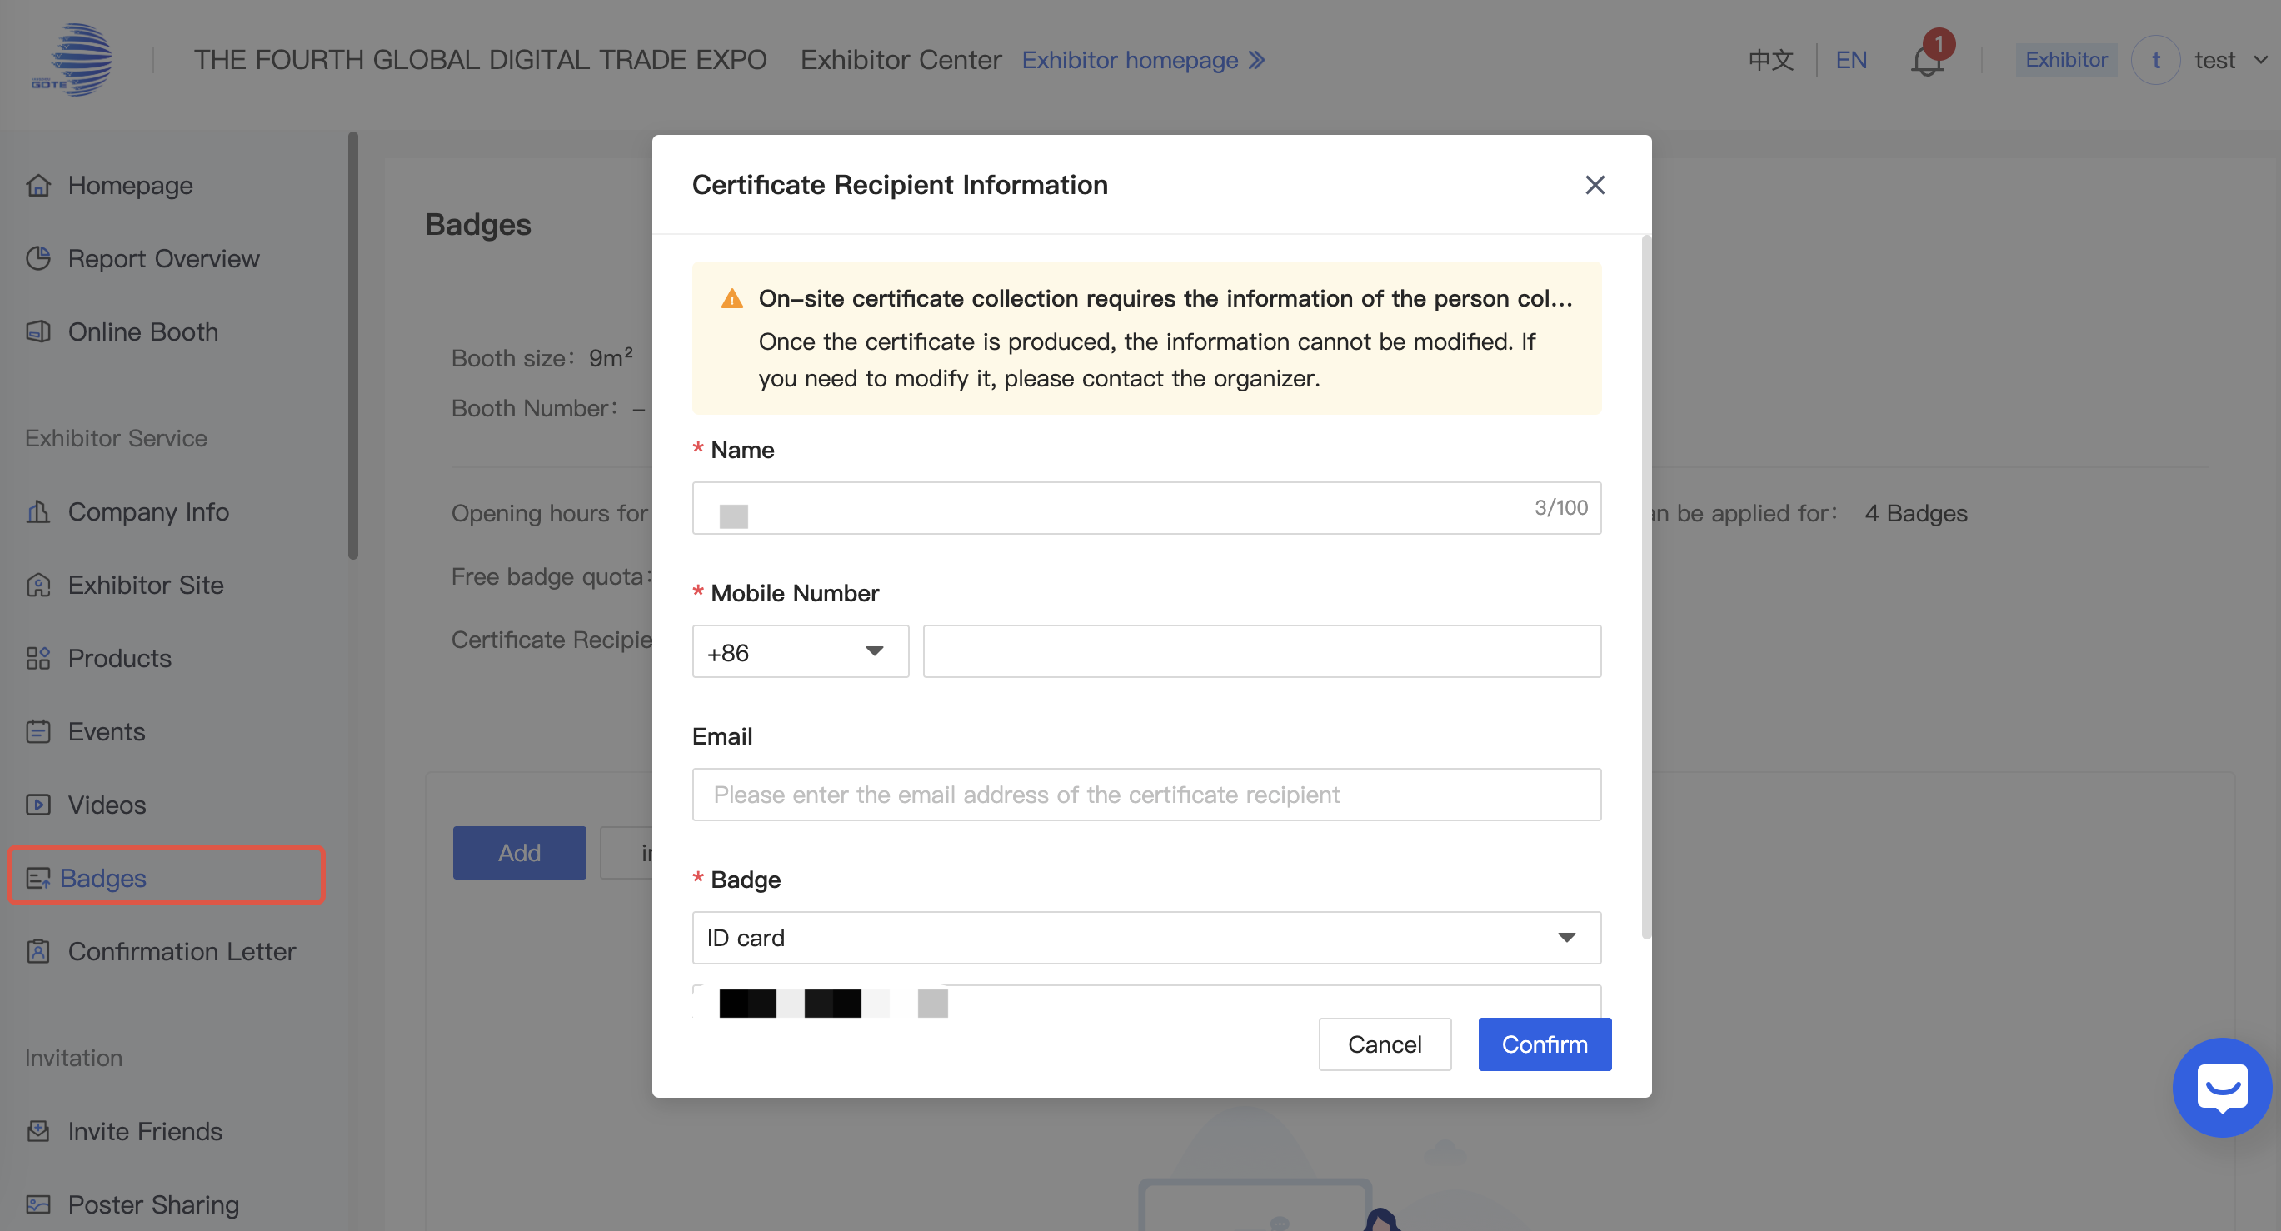
Badges
Click [Badges] to fill in the recipient's information for badge collection.
*On-site certificate collection requires the information of the person collecting the certificate. Please fill in the information of the person collecting the certificate in advance. Once the certificate is produced, the information cannot be modified. If you need to modify it, please contact the organizer.
PC

Slide 12
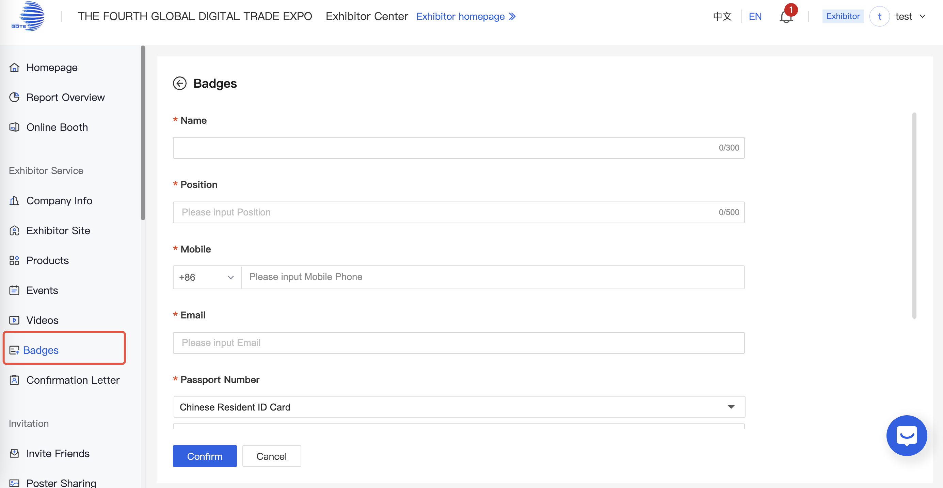
Badges-Add
Complete the applicant's information for the credential, then wait for the review to be completed.
PC

Slide 13
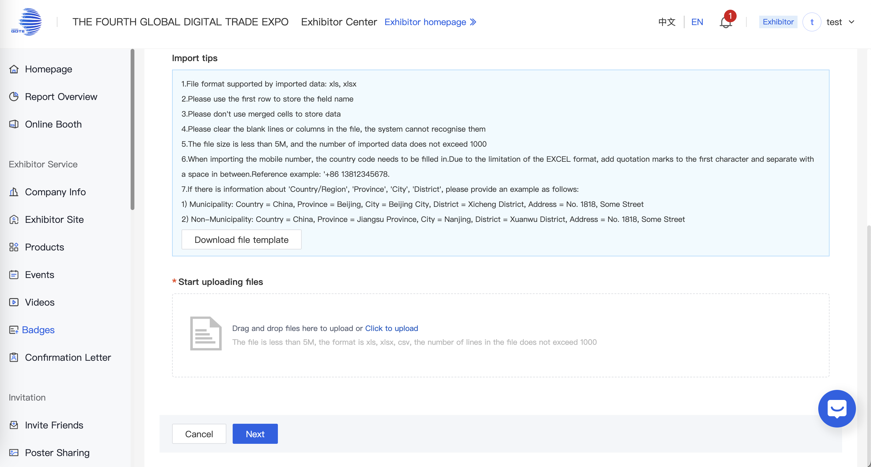
Badges-Import
1.[Download file template]-Enter the personnel details required for badge access-[Umploading Files]
PC

Slide 14
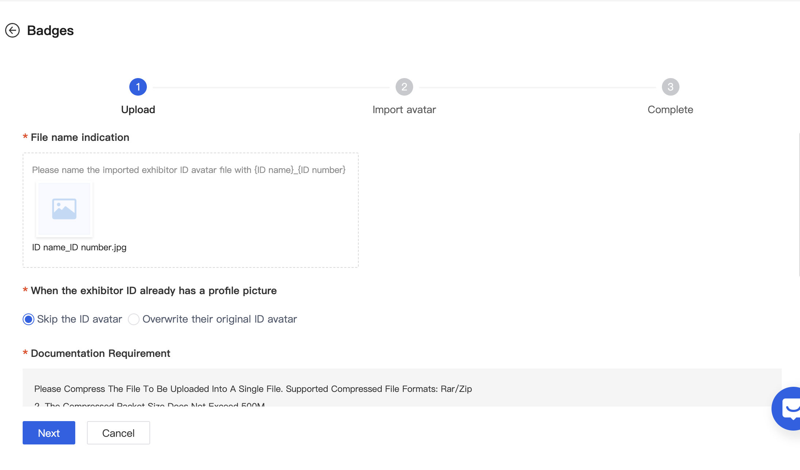
Badges-Import
2.[Import]-[Avatar]
*Please name the imported exhibitor ID avatar file with {ID name}_{ID number}:eg:ID name_ID number.jpg
Please Compress The File To Be Uploaded Into A Single File. Supported Compressed File Formats: Rar/Zip
2. The Compressed Packet Size Does Not Exceed 500M
3. Supported file formats for avatar pictures: jpg/jpeg/png, recommended size: 500*500; please pay attention to whether the format matches the format requirements of the target field before uploading, otherwise it will not work properly after uploading.
4.A single picture should not exceed 2M
Please Correctly Set The Corresponding File Name For The Uploaded File According To The Set Matching Rules
PC

Slide 15
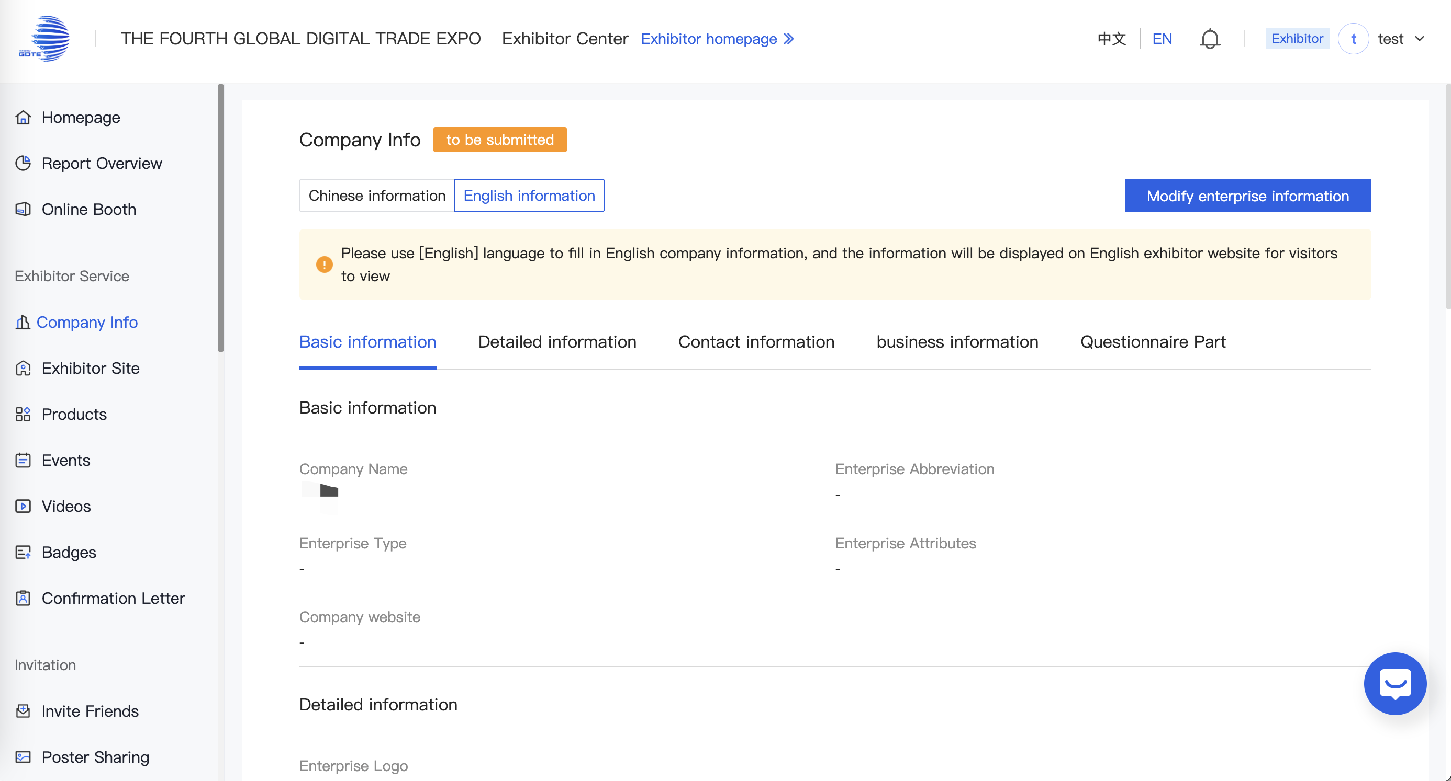
Edit Company Information
Access the Exhibitor Center after approval
Go to [Company Info] → [Modify enterprise Information]
Update the required fields
Click [Save] to finalize changes
PC

Slide 16
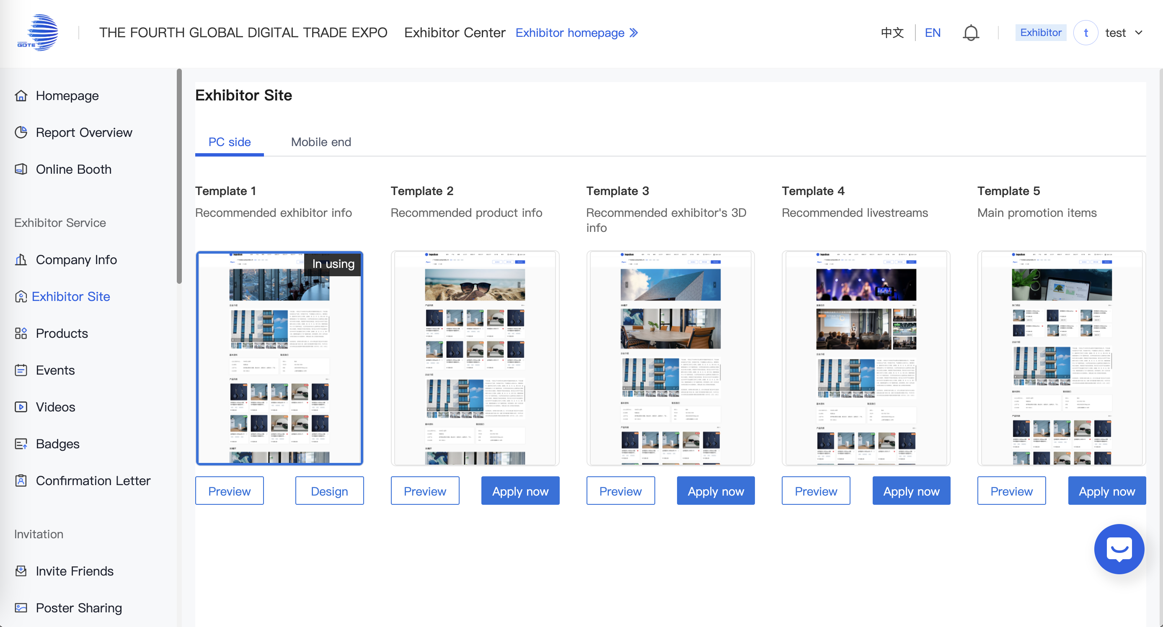
Exhibitor Site
[Exhibitor Site] → [Template Gallery] → [Select Template]
PC

Slide 17
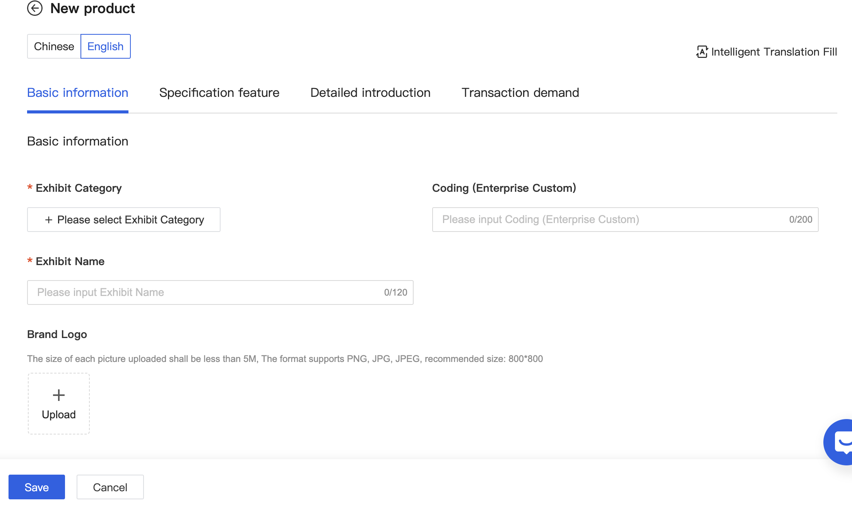
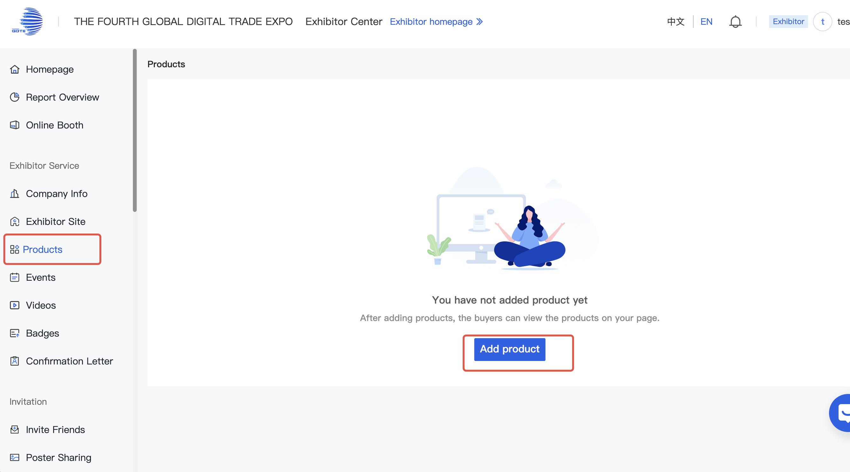
Products
On the [Products] page, you can add products and perform operations such as sorting, editing, and deleting uploaded products.
PC

Slide 18
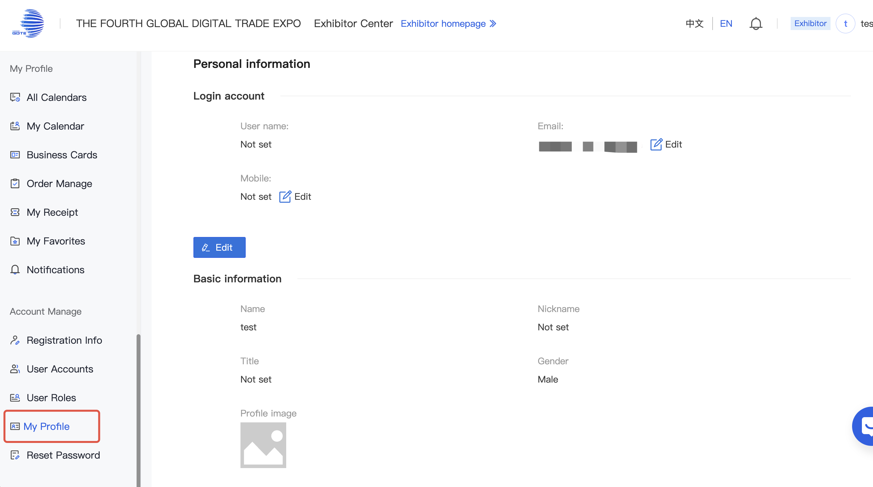
My Profile
On the [My Profile] page, you can modify your registered mobile number, email address, and administrator profile settings.
PC

Slide 19
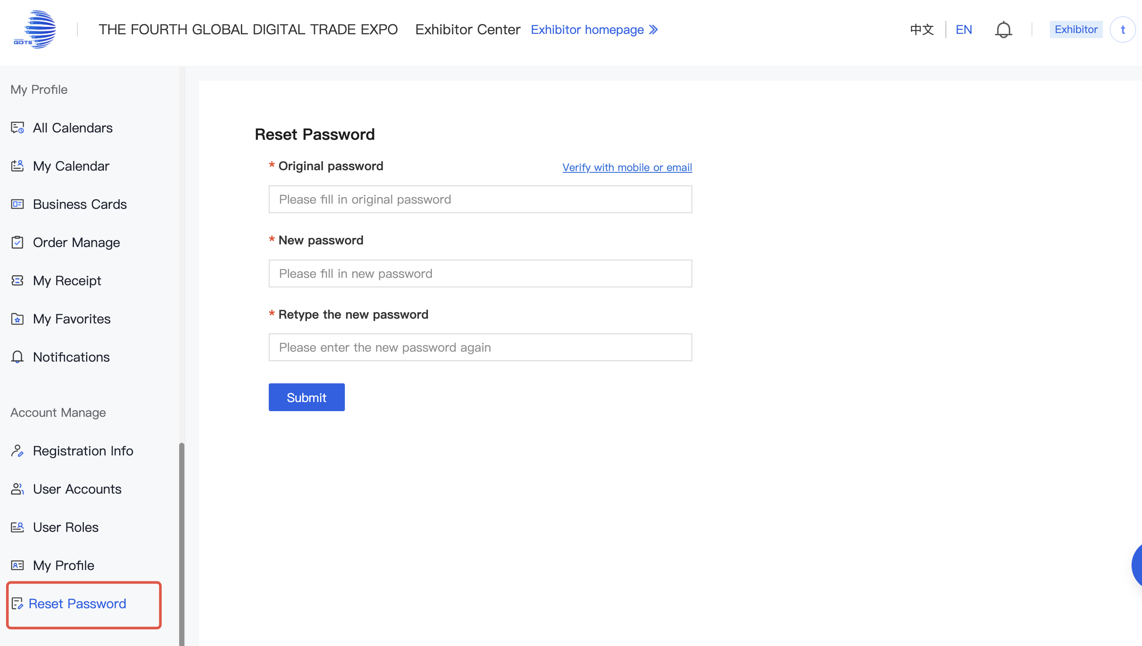
Reset Password
On the [Reset Password] page, you can reset your login password.
PC

Slide 20
THANKS

